Slide 1
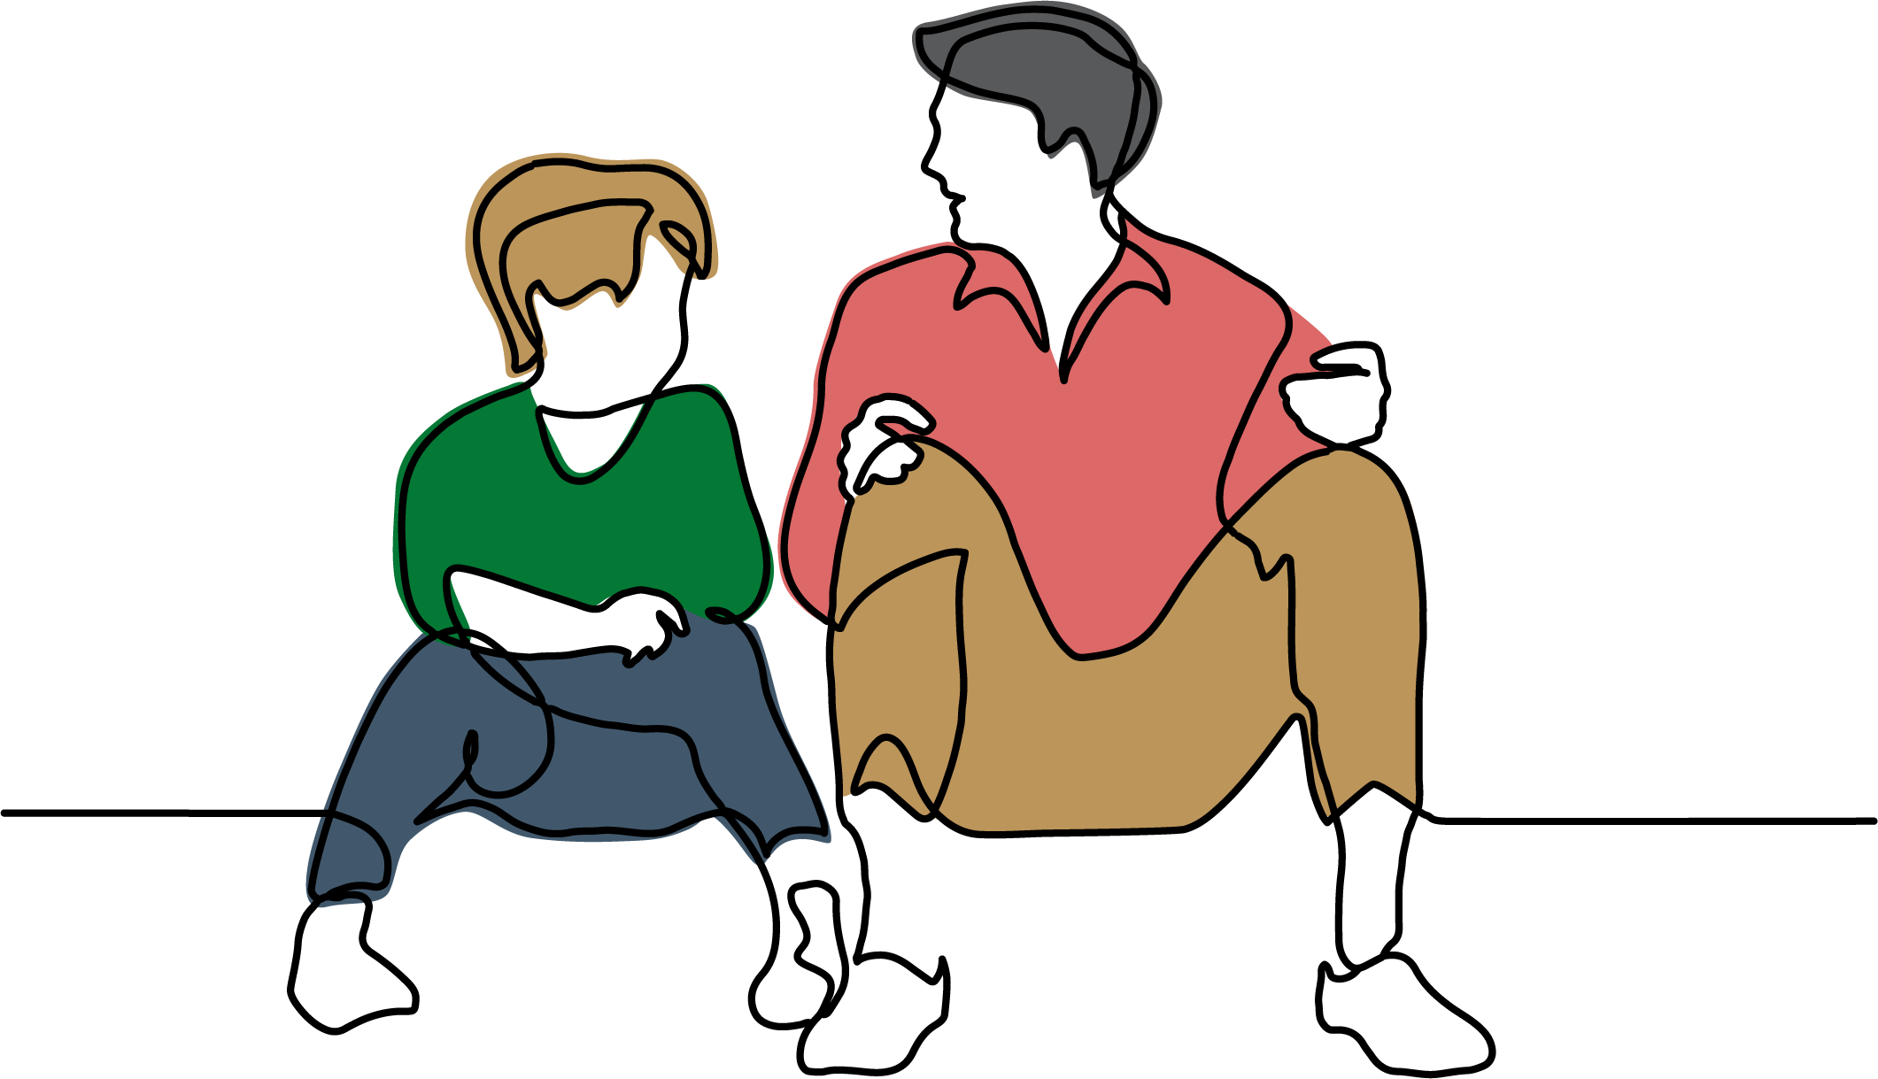
Caring for children & young people with trauma for foster carers
Notes:
Welcome participants to the training.
All videos are embedded in these slides but can also be found online here: https://vimeo.com/user/106396113/folder/16313446

Slide 2
Notes:
DCP-approved Acknowledgement of Country:
We acknowledge and respect Aboriginal people as the state’s first people and Nations, and recognise Aboriginal people as the traditional custodians of South Australian land and waters. We recognise that Aboriginal children and young people have the right to grow up in a safe and nurturing environment where their connections to family, community, language, culture, and country are supported, respected, and celebrated.

Slide 3
WELCOME
WELCOME!
As foster carers, you are essential in every way to the child you care for. Your relationship with them affects what they believe about themselves, and how they can trust adults to care for them.
Your positive relationship with your child is their key to healing and growth.
Notes:
Welcome to “Caring for children and young people with trauma”!
Introduce yourself and a little bit about your role and experience.
This course has been developed to have two versions, a version for foster carers and a version for kinship carers. They are very similar courses, but we know that there are some important differences in foster care: particularly, the additional challenge of building a long-term trusting relationship with the child in your care from the ground up.
Read slide text: As foster carers, you are essential in every way to the child you care for. Your relationship with them affects what they believe about themselves, and how they can trust adults to care for them. Your positive relationship with your child is the key to healing and growth.

Slide 4
COURSE OVERVIEW
The program is made up of 5 modules:
Module 1 – Introduction
Module 2 – Brain Development
Module 3 – Understanding Trauma
Module 4 – Trauma-Informed Approaches
Module 5 – Collaboration & Self-Care
Notes:
Over about 4 hours, we will go through 5 modules that together can help us understand the impact of trauma on how children and young people feel and behave, and how we can respond to their needs in a trauma-informed way.
Cover housekeeping, the planned schedule, group ground rules, and when breaks will be.

Slide 5
BEING A FOSTER CARER
What stands out to you about Christine and David’s experience?
or
What are some joys and challenges of foster care?
Notes:
Now we are going to meet Christine and David, who are experienced foster carers. While you watch this video, I want you to think about the journey of building relationships with foster children. What helps and hinders foster carers to build those relationships? What are the joys and challenges of building those relationships? Can you relate to some of the things that Christine and David say? After the video, we will introduce ourselves and pick something that stood out to each of us from the video.
01FC Being a foster carer [5 mins]
Let’s go around and introduce ourselves and reflect on some of the joys and challenges we heard from Christine and David. How do they compare to your experiences? You can choose the level of detail you want to share.
What stands out to you about Christine and David’s experience?
or
What are some joys and challenges of foster care?
Allow participants to introduce themselves.

Slide 6
MODULE 1: INTRODUCTION
Notes:
Let’s begin with the first module, which establishes the foundations for the rest of the training.
We will first look at how children develop through their relationships with others. As we go through the next few slides, think about the relationships that your child has had, with you, with their parents, their teachers, and other important people in their life.

Slide 7
Development happens through relationships – for better or for worse!
Notes:
Our key message for this module is: Development happens through relationships – for better or for worse!

Slide 8
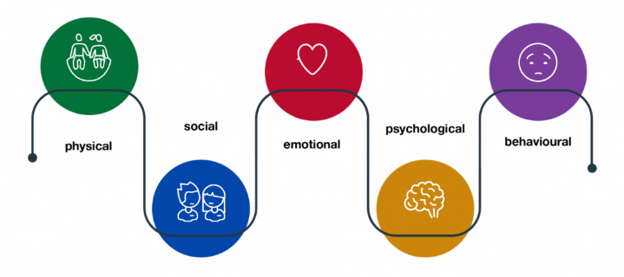
CHILD DEVELOPMENT
Children grow and develop across 5 domains:
Children are enabled to grow and develop across these domains through 3 types of opportunities:
Relationships
to feel safe
Safety
to be safe
Playing & Learning
to develop in safety
Notes:
Whether children are in foster care or still living at home, children develop across these five domains: physical, social, emotional, psychological, and behavioural development. Children are enabled to grow and develop across these domains through 3 types of opportunities: their relationships, their safety, and their opportunities to play and learn.
First and foremost are relationships. Relationships with caring and consistent adults allow children to feel safe, and to trust. When children have attuned and loving carers who recognise their needs and respond to them consistently, they can make sense of who they are and how the world works, and trust they are safe.
Second is the actual safety and predictability of the child’s environment. When routines are consistent, and children are rarely hurt across any of these domains, that allows children to feel safe enough that their brains can focus on playing and learning.
Repeated opportunities to play and learn are how children ultimately grow and develop across these five domains. Playing and learning are lumped together here because they are both about experimentation and checking your knowledge. An older 13-year-old child might practice different techniques in soccer or check if the negotiation skills that got him a better allowance will also get him an extension on his homework. A 6-month-old baby might repeatedly practice sliding her breakfast off the table to check that it will always hit the floor, or that if she points to her bottle, someone will give it to her. But babies will only experiment with pointing if they are safe (consistently fed) and feel safe (trust their carer will feed them whether the pointing strategy works or not).
This is how children’s development is so strongly impacted by their relationships with adults, especially their primary carers. When children experience abuse, neglect, or witness family violence, they miss out on the safety – and the trust in their safety – that allows them to experiment and learn how to play, how to take care of their body, how to communicate what they need, or how to stay calm when something bad happens. Genetics and personality also affect how children develop, but relationships and safety are key to allowing children to take these opportunities to play and learn.
Unfortunately, many children who come into care have experienced the trauma of abuse, neglect, and violence from parents that they depend on for their every need, which has impacted how their brain learnt to develop. This is called developmental trauma. Instead of spending time practicing skills and experimenting in a safe environment, these children’s brains are busy scanning for danger and preparing to react if something unexpected happens, interfering with the amount of focus they can give to learning and play. We will look at more about developmental trauma in Module 3.

Slide 9
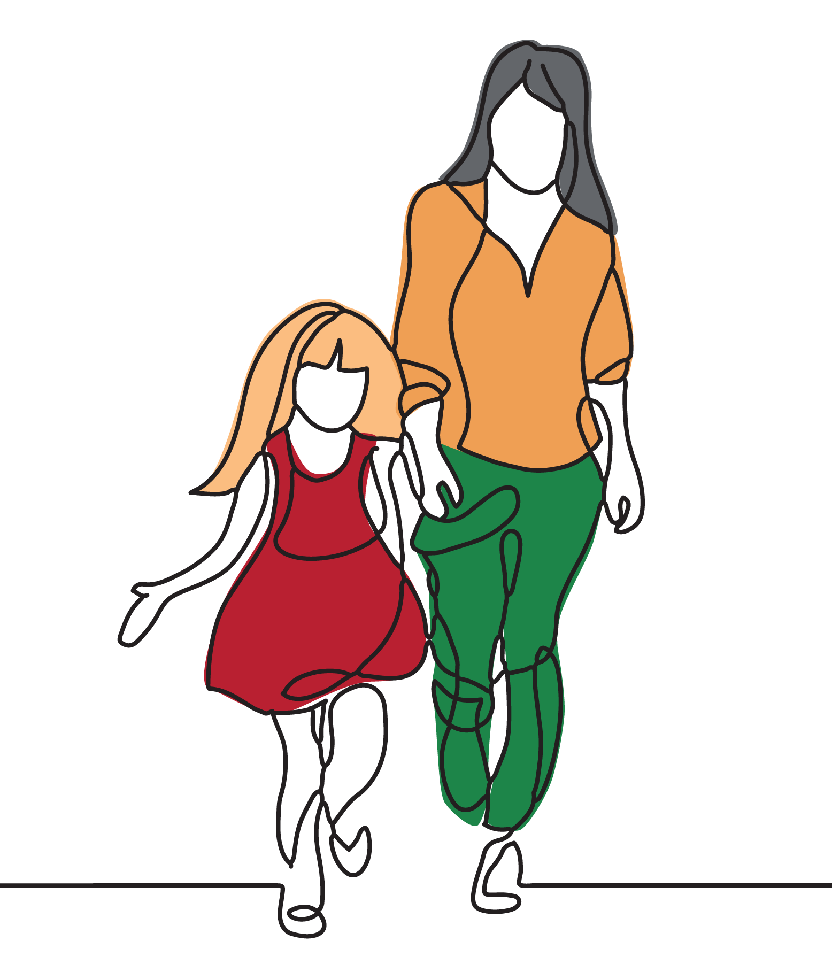
THE FOSTER CARE RELATIONSHIP
Foster carers help children heal and grow by:
Using their relationship to help their child feel safe
Providing an environment that is safe
Providing safe opportunities to play and learn
Relationships
to feel safe
Safety
to be safe
Playing & Learning
to develop in safety
Notes:
As foster carers, you have the amazing opportunity to be part of a life-changing relationship that can give children everything they deserve in love and safety and allow them to heal and grow from what they have experienced.
We often hear foster carers say they don’t know if they’re really the right person to look after their child, maybe they don’t really feel like they’re necessarily the perfect parent or their child seems to have a lot of special needs. Sometimes, foster carers can find it frustrating if they’ve already parented other children before, but now their parenting skills don’t seem to work the same way.
The good news is that it’s not about your experience, your age, or your education. You ARE the right person for this role if you can build a safe and trusting relationship with your child. You can help children heal and grow by using your relationship to help them feel safe with you, providing a safe environment, and providing plenty of safe opportunities to play and learn.
It’s that simple – but it’s also that hard! Even though the care you provide is safe and gives them everything they need, your child has still learnt so much from past unsafe relationships. Those experiences cannot be unlearnt, although they can be expanded on and grown around. The sound of a neighbour’s baby crying, an excited tone of a voice yelling, spotting a blue Jeep, a slight pang of hunger, anything could be a signal to your child that danger may be present again, despite your reassurance. Their brain is quick to react with whatever it thinks might protect them from that danger: yelling, running away, breaking furniture, hurting themselves, closing down and withdrawing – even if what they’re doing makes it harder for adults to connect with them, care for them, and keep them safe.
This course is ultimately about understanding trauma so that you can learn how to use your relationship to help your child feel safe, even when that child seems to be pushing you away.

Slide 10
USING YOUR RELATIONSHIP TO HELP CHILDREN FEEL SAFE
Why are relationships so important for children who are healing?
Notes:
Now we’re going to watch a video where therapeutic specialists talk about why good relationships are the most important thing for children who are healing.
While we watch this video, I want you to think about your relationship with the child in your care and what that relationship teaches your child about themselves.
02 Relationship based practice [3 mins]
What stood out to you in that clip?
What do you think about “time in” versus “time out”?
If no one has heard of “time in”, take this opportunity to explain. Guide participants’ discussion around what children learn about themselves from “time in” versus “time out”.
Remembering that children need to feel safe and be safe to be able to develop through play and learning, what do you think is the difference between “time in” and “time out” for children with developmental trauma? Responding to behaviours with “time in” builds trust, rather than punishes. When children trust carers and feel safe, they can risk trying new ways to respond to their feelings. Children feel “time out” as a rejection, which makes them feel ashamed of themselves and reject carers out of self-preservation.

Slide 11
Development happens through relationships
Notes:
This brings us to our key message: Development happens through relationships – for better or for worse!
Foster carers have a tough job keeping their children feeling safe and being safe so that they can develop through play and learning. But as complicated as it sounds, your mission is very simple – focus all your efforts on connecting with your child and providing a consistent routine. When your child feels safe and is safe, they can risk experimenting with new strategies and developing new skills to keep themselves calm and enjoy relationships with family and friends.
In our next module, we’re going to look more at the science of how the brain develops, and how we can use that science to strategically feed healthy developing brains.

Slide 12
MODULE 2: BRAIN DEVELOPMENT
Notes:
Now we’re going to look at how the brain develops in childhood. This is really important because when we understand more about how the brain works, we can make better sense of what we’re seeing in our children’s struggles and what we know about their past. Everything that you experience leaves a mark on your brain.

Slide 13
Hurt brains can recover! A brain that feels safe can focus on play and learning
Notes:
This is our key message for this module: Hurt brains can recover! A brain that feels safe can focus on play and learning.
We learnt in the last module that children need to feel safe and be safe before they can take advantage of opportunities to play and learn. This module looks at how to strategically work on children’s developmental needs in the same order their brain develops, and how to give children opportunities for play that will match which part of the brain they need to build next.

Slide 14
HOW DOES THE BRAIN DEVELOP?
Notes:
First, we’re going to watch a video on how the brain develops. At the end, I want you to think about which part of the brain children use to respond when they feel stressed and unsafe.
03 Thoughtful parenting [3 mins]
When children feel stressed and unsafe, is it easier for them to respond with their thinking brain or their emotional brain?
Emotional brain
Children need to feel calm and safe before they can use their thinking brain. But it’s not always easy to help them feel calm! As we just saw, we can try to reason with a child or encourage them to count to 10, but if their thinking brain isn’t back online yet, they aren’t hearing a word we say. The only way to help children who are thinking with their emotional centre is to try to use your relationship to help them feel calm and safe – so their thinking centre can come back online.
What are some ideas for how you could use your relationship to soothe children and help them feel calm and safe?
Steer answers towards sitting with them, hugs, acting calm, speaking with a soothing voice, nodding, listening, removing distractions, acknowledging their feelings

Slide 15
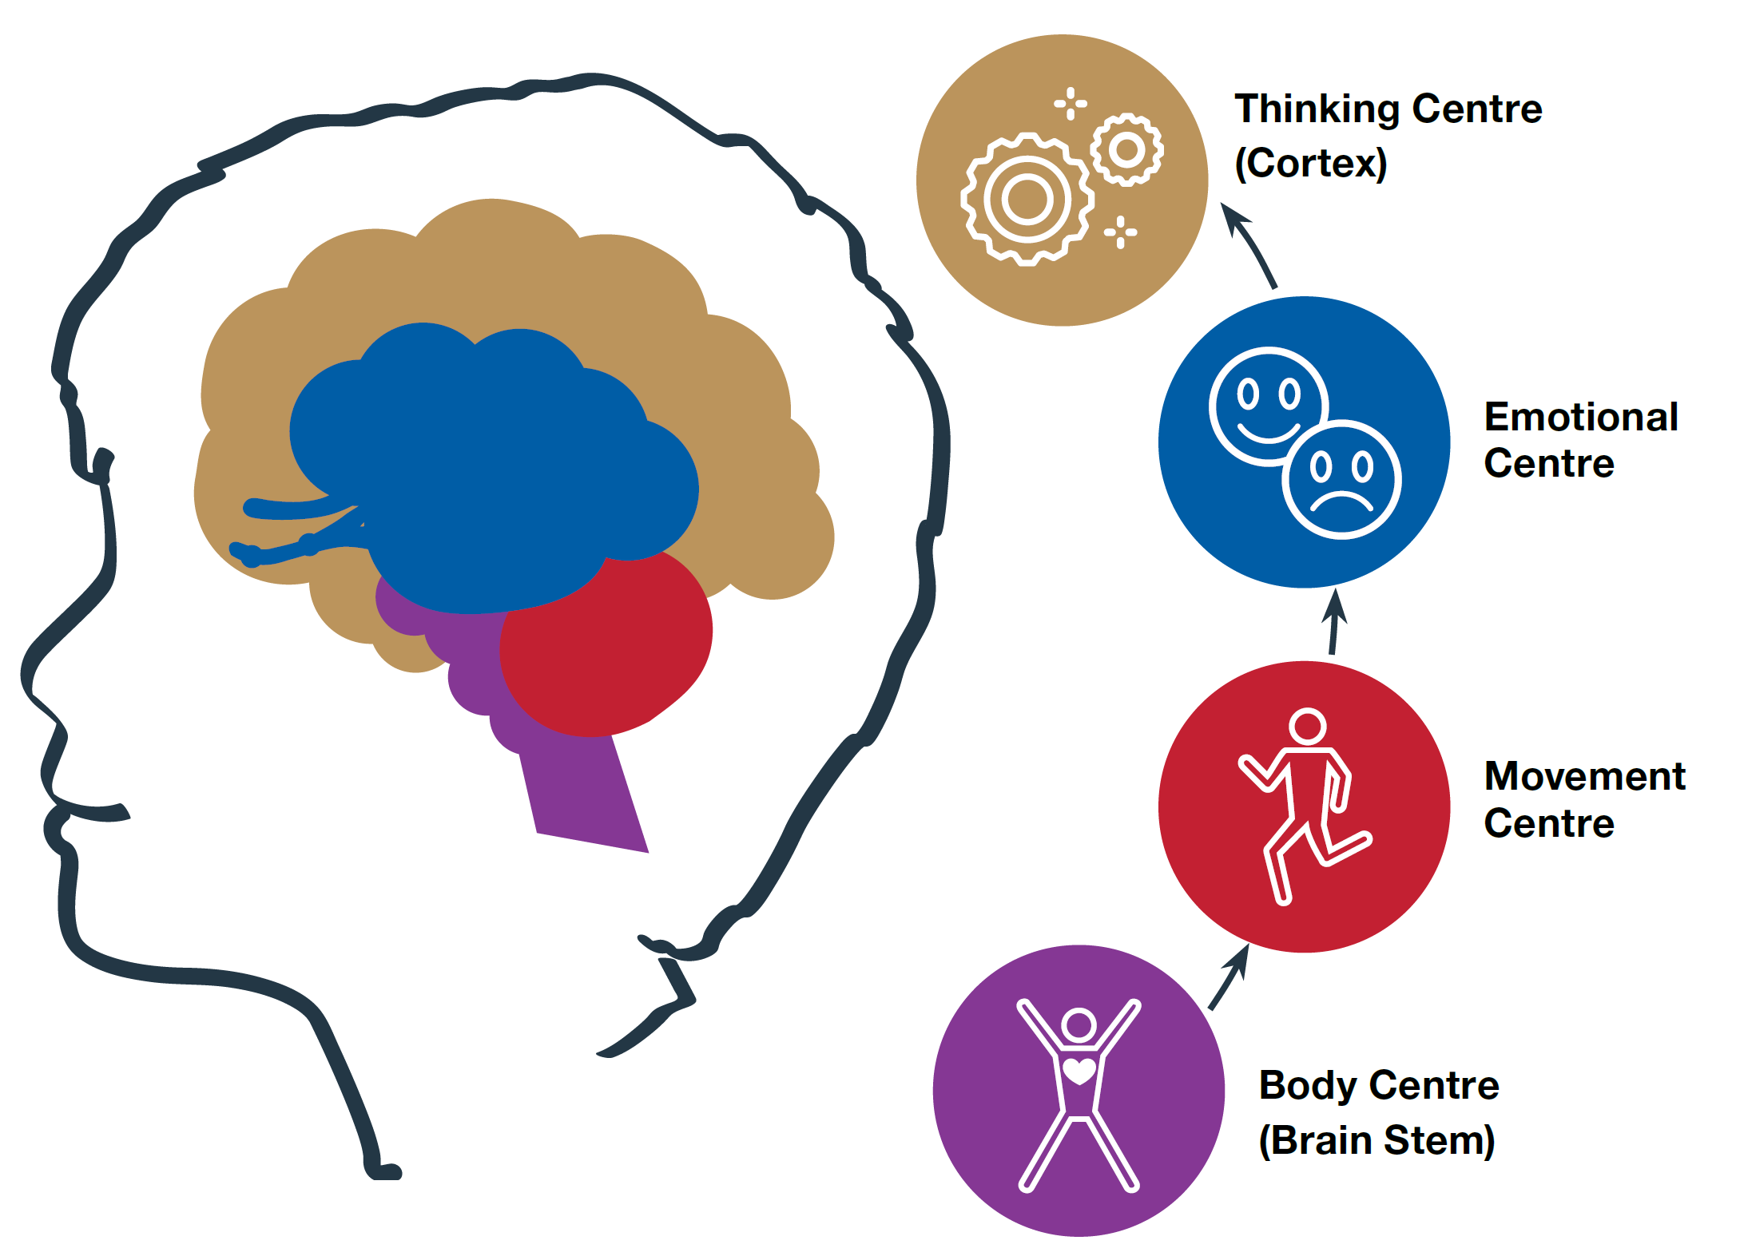
BUILDING BLOCKS IN THE BRAIN
Womb – 18mo
18mo – 5yo
5yo – 12yo
Adolescence
How to progress upwards:
Feeling safe
Being safe
Opportunities to play & learn
Additional hand-out
Notes:
Now let’s review how these four building blocks of the brain develop.
Use the left illustration on the slide to show the order of build. Provide handout for participants to have and reflect on through discussion.
First is the body centre or brain stem, then the movement centre or cerebellum, on to the emotional centre or limbic system, through to the thinking centre or cortex. Humans develop in this order to have the most basic skills for survival, like breathing and running, before they can move on to more advanced skills that could help them find a mate or collect food more efficiently.
Use the right illustration on the slide to show the developmental age groups
Here you can see how children develop these building blocks of the brain across their childhood.
Womb – 18 months
This is a period of huge development for babies in their body centre and movement centre. Babies in the womb develop their breathing, swallowing, reflexes, and their ability to wiggle. Once born, they are practising leaning, moving, sitting, and exploring. Although they have feelings, there is not much rationale at this stage. Babies instinctively cry when they are uncomfortable, and only if an adult helps them be comfortable by feeding, cuddling, and changing them, can they devote their energy to learning the basics.
18 months – 4 years old
In the toddler and preschool years, the movement centre is working on bigger skills: climbing, kicking, jumping, and dancing. Their thinking centre is starting to see cause and effect and learning to use language to communicate needs. However, the thinking centre is still only young. When emotions take over, children lose the ability to use their new language skills and slip straight back into easier ways to communicate. Crying is no longer just instinctive, but also used intentionally to communicate feelings, along with facial expressions and postures, and acting out certain behaviours. These younger children check the feedback that they get to help guide them through challenges, and this also helps them learn to understand feelings.
5-12 years old
School-aged children are now developing more delicate movement skills like writing and drawing. The thinking centre is learning more advanced language and figuring out how to solve complicated problems. Children in primary school are now beginning to use their thinking centre to manage their emotional centre, they are learning to regulate their feelings. This means that unless they are in immediate danger, they will intentionally hold back tears in front of their friends or squeeze their fists instead of screaming with excitement when they’re in public, so they can come back later to process big feelings when they’re alone. However, if children don’t feel secure or their thinking centre is underdeveloped, children will quickly resort to behaviours and loud noises to express their feelings in a way that comes more easily to them.
Adolescence
Adolescence is when all these things come together to build the foundations for adult life, along with adult hormones that prepare the body for sexual development and a more advanced sense of identity. Adolescents are becoming who they truly are, independent of their guiding adults, so they are developing skills they are personally interested in, and losing motivation to do things that don’t seem useful to their goals. The thinking brain has a big task that has become more important than ever: understanding who I am, what I believe, why I do things, and which groups I belong with. For teenagers who do not have strong relationships with family, friends, kin, and community, this is a painfully confusing time. When you add developmental trauma, the thinking centre can still struggle to stay in control of the emotional centre, so a teenager may behave in extreme or surprising ways that can further impact how they see themselves and how they feel they belong with others.
The way forward for children of any age is just as we saw in the previous module: if they feel safe and they are safe, and they have opportunities to learn and play, then their brain can focus on developing upwards, through the movement centre skills, onwards through the emotional centre skills, all the way to the thinking centre skills. It’s developing the thinking centre that allows children to strategically respond in a way that meets their needs efficiently and calmly.
So let’s assume our children are safe now. They live in a safe home, they have plenty of food and time to play, and they have us as carers to supervise them to make sure they’re never in danger. Some children, especially early in their care placement, don’t believe that this living situation is safe, which might be fair enough considering their past experiences. However, especially after a while, many children in care do “know” that this living situation is safe in theory, but they still just don’t feel safe.
What makes people feel unsafe even when they “know” in theory that they are safe? If participants are struggling, suggest non-dangerous scary activities: flying in an aeroplane; public speaking; your first driving lesson; an important exam. When taking answers, reiterate the element of the unknown within each answer.
So, like us, children are able to feel safe when they are familiar and practised and know what will happen. We can do our best to describe what’s coming, which could be useful for unusual events like birthdays and holidays. For daily activities, one powerful way to help children feel secure that they know what’s coming is to develop a strong consistent daily routine. If you have a strong routine where the same activities happen in the same order every day, children will start to relax and feel safe, because they are always seeing that the thing they expect to happen next is, indeed, exactly what happens next. This is important to the brain because the brain functions best when there is a pattern to follow. The brain is a pattern-making machine.
This means we have to find a routine for children that gives them the opportunity to learn and play, integrated into a routine that helps them feel safe.
For a baby developing their body centre, this might look like extra cuddles when attending to every cry, consistent pats on the back to help them get to sleep, or a game of peek-a-boo after every changed nappy.
For a toddler working on movement, this might be copying each other’s silly walks on the way to day care or painting together while dinner is cooking. A pre-schooler working on emotions could help you tell stories about their toys on car trips or take turns with you to eat a mouthful of peas at dinner. For a school-aged child, you might make games where you have to guess what past event they’re describing using only adjectives or challenge them to make 10 from numbers you can see on number plates.
The focus is always on providing a calm and safe environment to play and have fun, which is how children can learn and develop. Practising these things in tiny repetitive interactions with you is the key to developing their skills. After 100 safe experiences of describing their toys’ feelings to you, children will trust you enough to become good at describing their own feelings – to you, and then eventually to others.

Slide 16
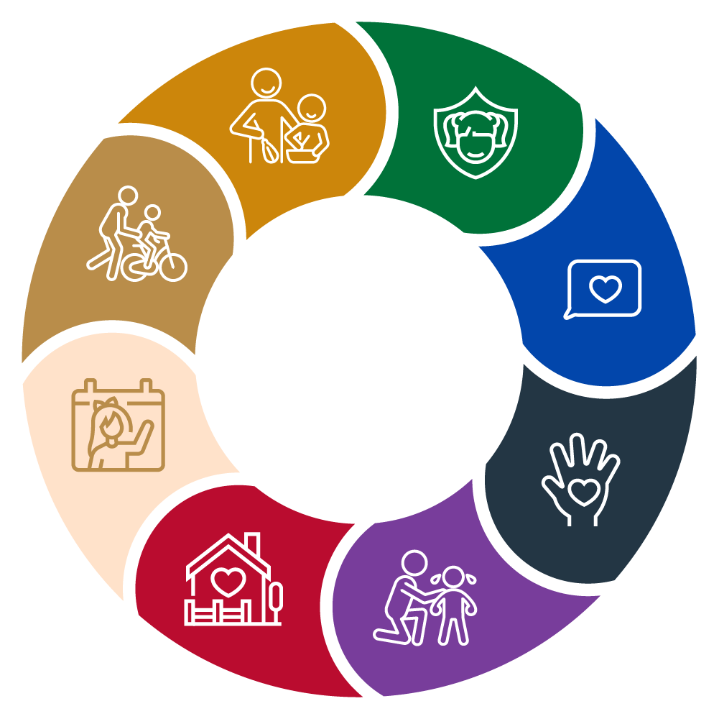
OPPORTUNITIES FOR PLAY IN SAFE ROUTINES
A developmental skill your child is struggling with?
Opportunities for developing that skill through play?
Incorporating those opportunities into your routine?
How many games would it take?
Notes:
For larger groups, you may want participants to approach these questions in pairs.
Let’s think of some safe playful games that might help the child you care for develop the skills they need the most practice with.
What is a skill your child is struggling with more than others their age?
E.g. speaking whole sentences, describing their feelings, reading, showering
What are some opportunities for playing with you that would help them learn that skill? E.g. copycat games, eye spy, pretending to shower a dolly
How could you incorporate those opportunities to play/learn into a predictable daily routine?
E.g. copycat games on the walk to the park, eye spy in the daily car ride
How many times do you guess it would take playing this game (or variants of the game as it evolves!) for your child to get pretty good at that skill?
This answer is to show that the barrier is more in practising than struggling. It can feel like children are always behind, when really, they are a mere hundred games of “doctors” away from skilfully describing physical sensations.

Slide 17
Development happens through relationships Hurt brains can recover! A brain that feels safe can focus on play and learning
Notes:
This brings us to our key message: Hurt brains can recover! A brain that feels safe can focus on play and learning.
Next, we are going to look more closely at how trauma can impact how easily children can feel safe with you, and what that means for the way that they learn to behave.

Slide 18
MODULE 3: UNDERSTANDING TRAUMA
Notes:
Now we’re going to look at understanding trauma and how it impacts the children we’re caring for. Now that we know how the brain develops in childhood, this is about how trauma impacts that development, by shutting down the higher functions so that the child can focus on survival.

Slide 19
Understanding trauma helps us respond to children by helping them feel safe
Notes:
Our key message for this unit is: Understanding trauma helps us respond to children by helping them feel safe.
When we’re going through our daily challenges with children in our care, it’s helpful to remember the impact of trauma on their brain. When we understand that children are struggling because their brains are in “survival mode”, that can help us remember to focus on helping children feel safe first, before we approach what they’re struggling with. We call this connection before correction.

Slide 20
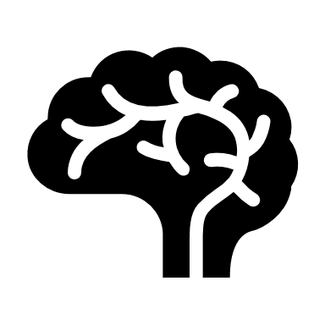
WHAT IS TRAUMA?
SIMPLE
TRAUMA
COMPLEX
TRAUMA
DEVELOPMENTAL
TRAUMA
Notes:
First, let’s look at what trauma is. When we hear about “childhood trauma”, there are a few different types of trauma we could be talking about.
The first is simple trauma or single-incident trauma. This is like a dog bite, a car accident, or witnessing something terrifying, where that one incident causes psychological harm and continues to impact your life, even if it happened a long time ago. Someone who’s experienced this trauma might avoid all dogs, or decide they don’t want to learn to drive, and it can impact their life in increasingly severe and disconnected ways.
Next is complex trauma, which is a repeating pattern of traumatic events happening over time. The majority of children in out-of-home care have experienced complex trauma as relational trauma in the context of a close relationship, where an adult who should protect a child instead abuses or neglects them. This relational trauma involves an adult significantly betraying the child’s trust, which impacts the brain’s ability to form trusting relationships and feel safe.
Developmental trauma is when traumatic events impact how the brain develops. Children are more vulnerable to developmental trauma the younger they are because brains slowly become less flexible as babies age into children. Often, developmental trauma occurs in infancy or before birth. If a baby is regularly left hungry with a dirty nappy or is exposed to family violence or substance abuse before they’re born, their brain fills with cortisol, the toxic stress chemicals that can put the baby in a permanent state of stress, and physically change how their brain makes connections.

Slide 21
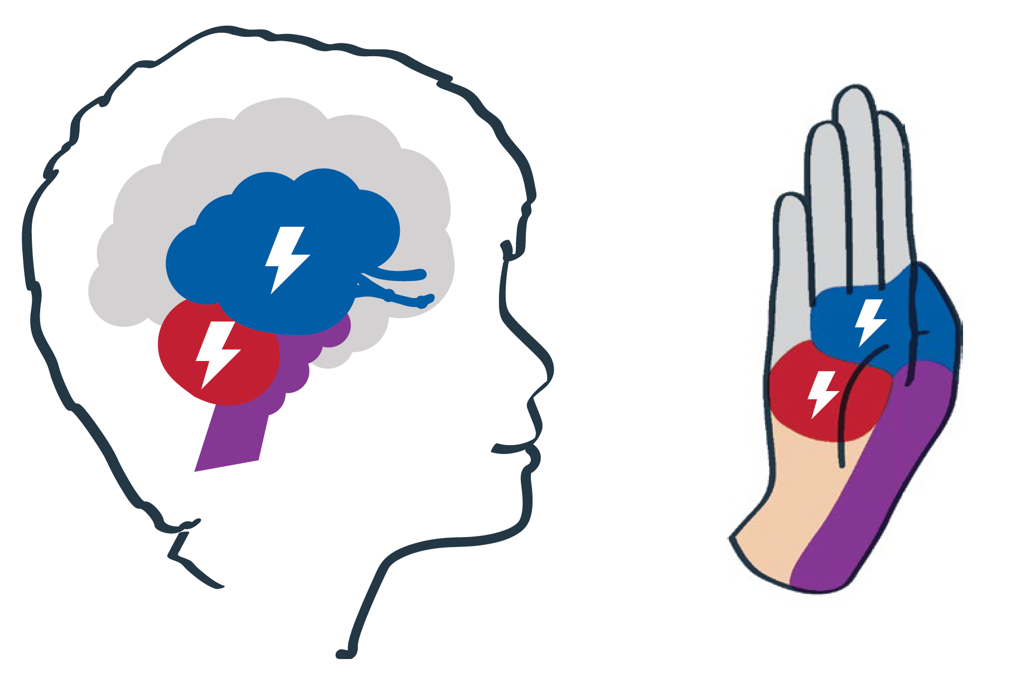
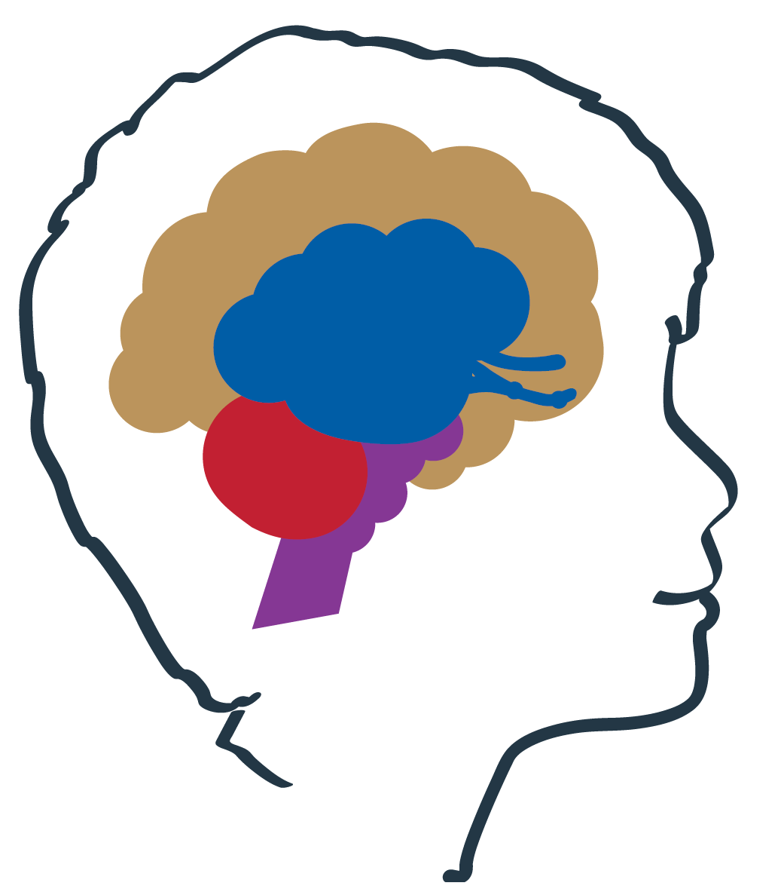
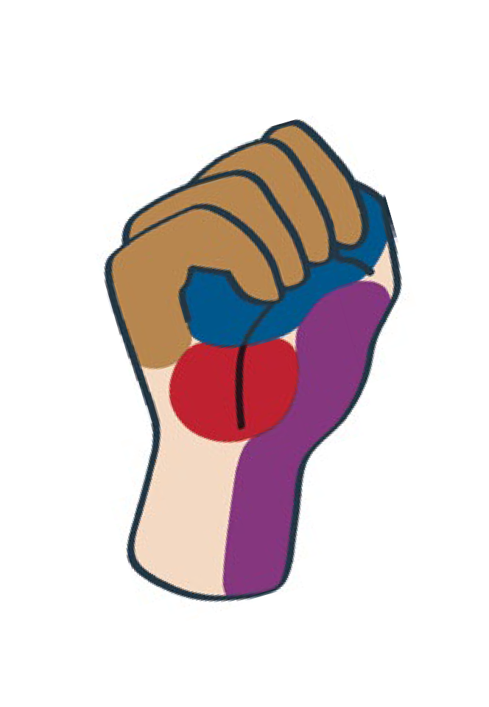
THE THINKING BRAIN AND THE EMOTIONAL BRAIN
What happens when children “flip their lid”?
“Flip their lid” = lose connection to the thinking brain, a.k.a. brain in “survival mode”
Notes:
Let’s watch a video where Dan Siegel describes how the thinking centre can lose control of the emotional centre temporarily when we’re seriously upset. This happens to all of us at any age, when we lose our temper or feel too upset to speak. This is a fantastic way to simply explain how your thinking brain can lose control of your emotional brain to children of all ages.
04 Hand model of the brain [2:30 mins]

Slide 22
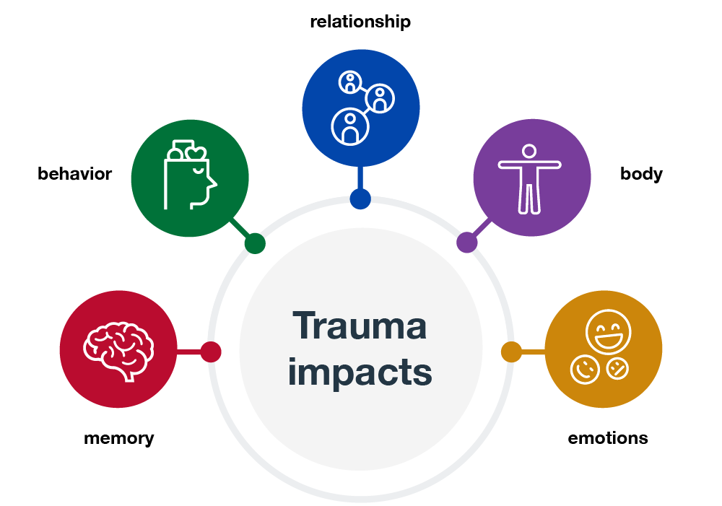
THE THINKING BRAIN AND THE EMOTIONAL BRAIN
What happens when children “flip their lid”?
“Flip their lid” = lose connection to the thinking brain, a.k.a. brain in “survival mode”
DANGER!
Notes:
What happens to children when they “flip their lid”? Use the graphic to help prompt participants to cover memory, behaviour, relationships, body, and emotions.
This video is a creative way to illustrate what happens when we are so overcome with emotion that our brain switches into survival mode. When children experience ongoing abuse and neglect, over time, their brain learns to anticipate danger and starts getting really good at switching to survival mode! You can see in the “flipped lid” diagram, this child’s brain has perceived danger, so it’s flooding with stress chemicals that shut down the thinking centre, leaving the emotional, movement, and body centres to tense the body, raise the heartbeat, and get ready to fight, flight, or freeze.
When children experience scary situations or relationships daily, the thinking centre can be shut down so often that the brain doesn’t get much chance to develop the thinking centre.
What do you think happens when children “flip their lid” too often and don’t get the chance to develop their thinking centre? Take some ideas. Guide answers toward overdeveloping fight/flight/freeze responses and not developing skills that need the thinking centre: problem solving, memorising information, understanding cause and effect, rationalising events, and understanding long-term consequences.
When people sometimes describe children with developmental trauma as “stuck in their feeling brain”, this is what that means. These children can suffer issues with their memory, behaviour, relationships, body, and emotions, because the part of the brain that allows children to remember, think rationally, and make sense of their situation is underdeveloped, and the ability to react emotionally is becoming overdeveloped.
The good news is that all children are capable of healing and developing their thinking centre because the brain never stops being capable of change! This is called brain plasticity. Has anyone heard of this?
However, we know that as children age, it can take longer and longer to create those connections and practise those skills, as the brain is slowly losing plasticity and becoming less flexible into teenagerhood and adulthood.

Slide 23
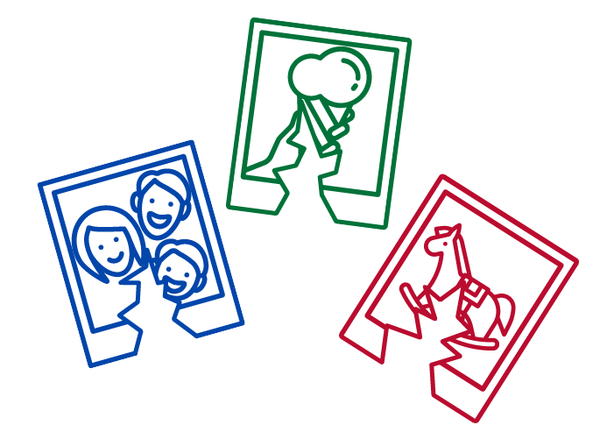
TRAUMA AND MEMORY
Impaired working memory function
Trauma stored as sensory fragments
Notes:
First, we’ll look at the impact of trauma on memory. When stress chemicals shut down the thinking brain, the memory centre comes offline, so the body can prepare to react with fight, flight, or freeze. If a child feels unsafe, the brain may be scanning for danger and not codifying memories, even before we’re seeing any unusual behaviours.
This makes children’s memory less effective, both at recalling what happened over the day, as well as “working memory” – the memory skill of remembering multiple steps of a task. For example: if you ask a child to put their bag in their room, get out their homework, and come to the dinner table, it’s common that children may put their bag in their room and stay there, distracted by something and forgetting the other instructions. You can see why this is easy to mistake as refusal or laziness!
How could trauma’s impact on memory affect a child’s experience of school? Children may miss many instructions, they may not retain what they learnt well, they may forget homework, they may be penalised for late assignments…
The other impact that trauma can have on memory is that children can have fragmented recollections of their past. The experience of abuse and neglect is intense and overwhelming, so the brain struggles to store the whole memory as a cohesive story but rather stores it in sensory fragments.
Sensory fragments could be a sound, like someone yelling or a certain tone of voice; they could be a smell, like cigarettes or toast; a touch, like a hand on their head, or other sensations, like being bounced or being wet. These fragments become separated from the story of what happened but still trigger an intense response, sometimes just like reliving the abuse inside the brain. Without knowing why, the child might jump into survival mode, shutting down the thinking brain to prepare the body for fight, flight, or freeze. The child may suddenly be screaming or running out of the classroom or do any number of things, just because the teacher spoke in a certain way that triggered the brain to subconsciously relive past abuse.
Even seemingly inexplicable behaviours often make sense if you know the whole story. Without any safe adult who can help to link their current experience with past abuse, children are often just as baffled as anyone about what compelled them to react suddenly. With no other explanation, children often find it easy to chalk it up to “just being a bad kid”, which goes on to create a cycle of self-worth issues without ever really understanding that their past is not their fault.
Many times, you’ll have no idea what the trigger was, but over time you might see a pattern, or you may know enough about their past experiences to make a good guess. When a safe adult can suggest good reasons, a child might have had to react, that can help the child make sense of their reaction and feel less ashamed, and ultimately learn to have better control.

Slide 24
TRAUMA AND BEHAVIOUR
Pick a behaviour you find challenging to manage. What need could that behaviour be communicating?
Should we give children attention when they display “attention-seeking behaviour”? Why or why not?
Notes:
Now that we’re considering how stress chemicals shut down the thinking brain to prepare it for fight-flight-freeze, this is a good time to explore trauma-based behaviour.
The behaviour that comes from fight-flight-freeze is not unique to children in care. Every human that feels unsafe has these chemicals that shut down the thinking brain to prepare us to fight, run away, or play dead. If we didn’t, we’d have never survived the stone age! Children in care have the same behaviours as all children, but because their brain is more ready to perceive and react to danger, those behaviours can be more frequent and more intense. These children are often hyper-sensitive to the risk of threat.
05 Understanding trauma-based behaviours [3mins]
For larger groups, you may want participants to approach these questions in pairs.
Pick a behaviour you find challenging to manage. What need could that behaviour be communicating?
E.g. food hoarding might communicate a need to have a backup stash of food; lying might communicate a need to protect oneself from abusive punishments.
Should we give children attention when they display “attention-seeking behaviour”? Why or why not?
Ensure participants understand that children need close attention, and that attention helps them feel connected and soothed by their carers. When children feel safe and are safe, they can develop their thinking centre to learn strategies to meet their own needs.
Learning to think of behaviour as a means of communicating something can help you see children for who they really are, and empathise with how challenging it is to feel that relationships can’t be relied on.

Slide 25
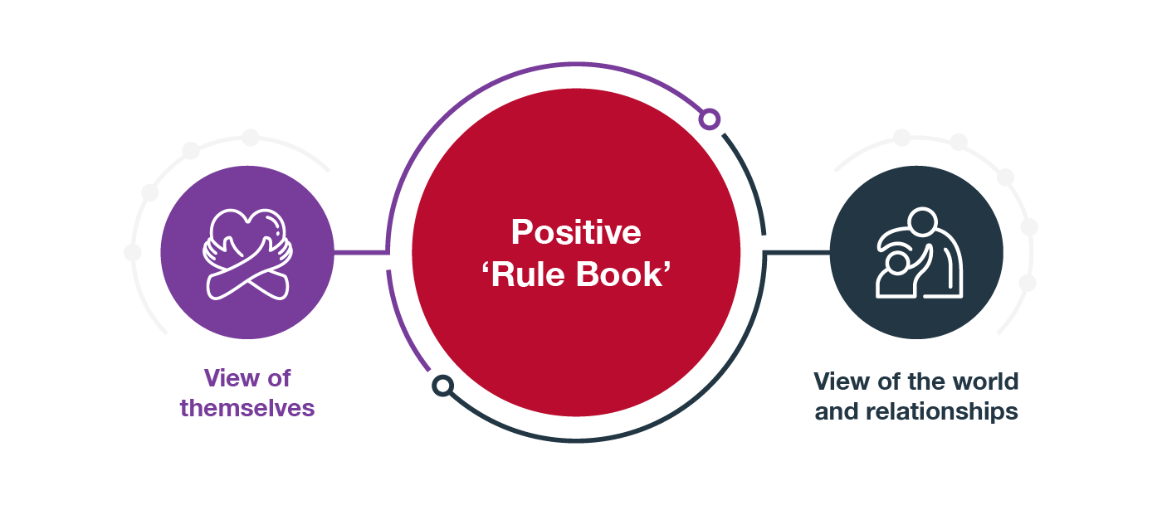
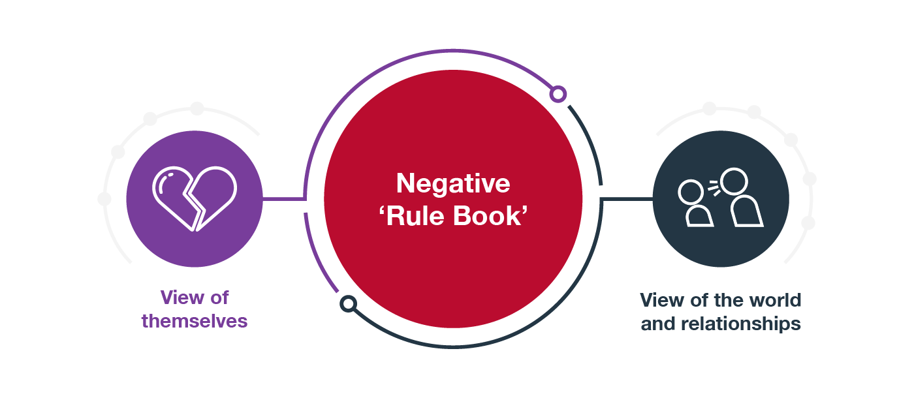
TRAUMA AND RELATIONSHIPS
loved
people care about me
learning
I can ask for what I need
deserving
I’m always protected
“good kid”
I deserve kindness
included
I have great friends
special
we’ll resolve any fights
unlovable
nobody cares about me
naughty
you can’t trust anyone
selfish
I’m always in trouble
“bad kid”
kindness is fake
friendless
I’m never invited
weird
everyone hates me
Notes:
Experience is what teaches our brain about relationships: how they work, how to engage, what to give, what to get, and how to behave towards others. This becomes our relationship template, or “rule book”, for what we expect from future relationships.
From birth, children attach to their primary carers and use this experience to establish the foundation of how they know to engage in relationships. When parents meet their child’s needs and are warm and responsive to them, children feel safe and loved, and learn that they are valuable good children who deserve respect. We call this the return and serve of the relationship.
Read some highlights from the “positive rule book” on the slide.
A child who has been abused or neglected by a primary carer learns that they do not deserve love, safety, kindness, or respect, and begin to expect that others will abuse and neglect them.
Read some lowlights from the “negative rule book” on the slide.
If this has been the child’s experience of their primary carers, it can take a long time to “rewrite the rule book” on how relationships should work. There is so much attachment-defining opportunity during early childhood. Children who have been unsafely attached to their primary carers through infancy may need many years of sharing safe and fun experiences together to truly learn that relationships are safe.
Children who have found that adults are abusive and do not provide comfort may reject your attempts to bond with them, avoiding emotional engagement at all costs. These children can seem stoic and indifferent and may say things like, “Well, just kick me out if you hate me so much, see if I care”. This is particularly common for children who have experienced multiple placements and multiple relationship breakdowns.
On the other hand, some children who have experienced inconsistent safe relationships may seek out comfort indiscriminately from adults, peers, and even strangers. This can seem endearing in younger children, so is often overlooked, but when children are prone to misjudge the strength or nature of relationships, it can expose them to rejection and exploitation.

Slide 26
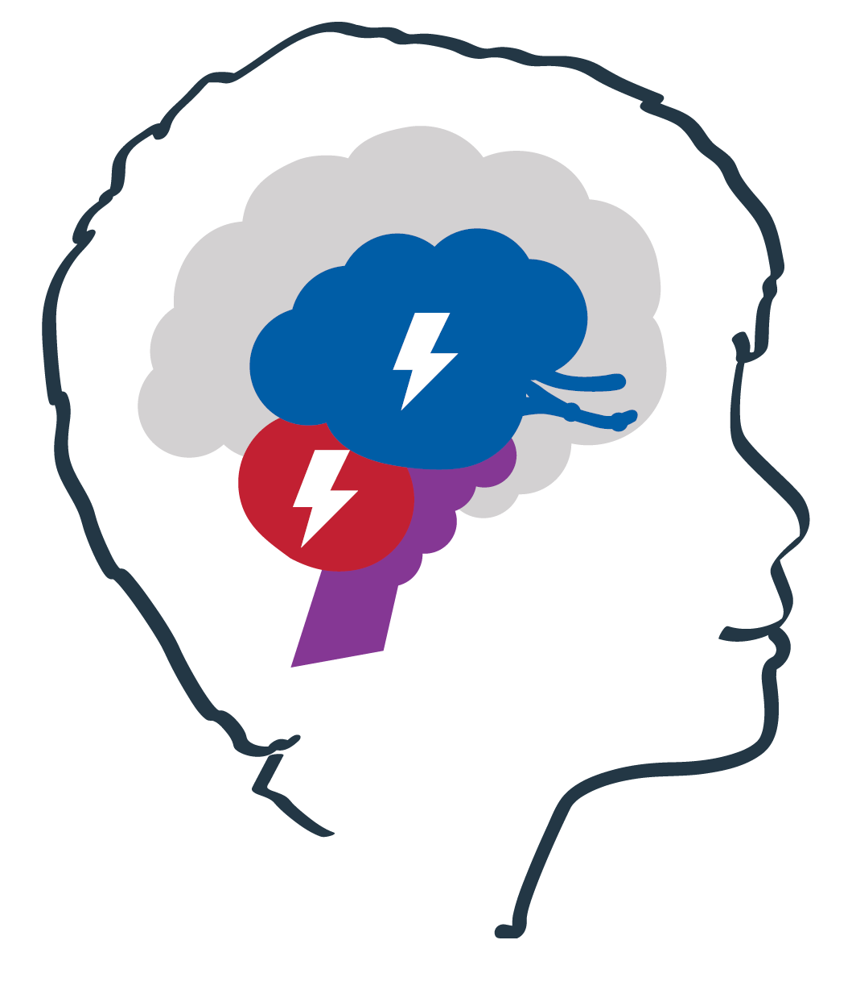
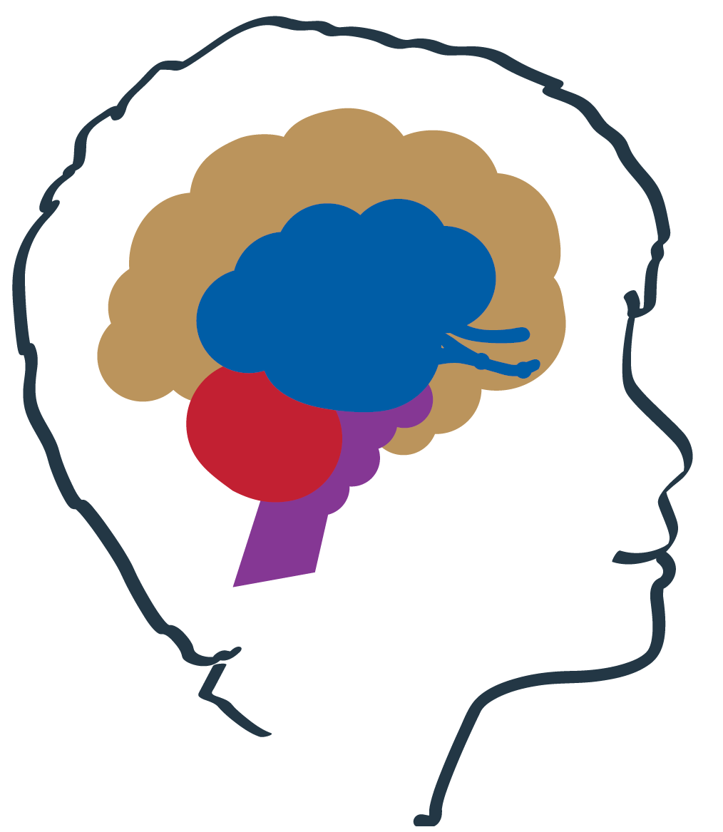
TRAUMA AND THE BODY
What can you guess “flipping your lid” feels like in children’s bodies?
Longer-term effects:
Muscular problems
Health problems
Sleeping problems
Appetite problems
Sensory problems
Notes:
We have talked a bit about how children with trauma can easily lose access to their thinking centre, leaving only their emotional, movement, and body centres to respond to danger. Now it’s time to think about the chaotic experience of trauma that children feel in their bodies.
For this next question, we have to think about the last time we flipped our lid at someone – a time we felt so scared or angry or upset that we felt out of control of our bodies. Maybe you stormed out and slammed the door, snapped and screamed at someone, or completely froze and weren’t able to say anything at all.
What can you guess “flipping your lid” feels like in children’s bodies?
Tense, sick, heart thumping, eyes prickling, choked up, sweaty, nauseous, dizzy, stiff
Would this have been a good time to tell you that your behaviour is unacceptable and you should try counting to ten?
Apart from the short-term effects of perceiving danger, there are long-term effects that build up in the body and can impact children’s daily lives. They can feel permanently tense and rigid, they can have regular headaches and stomachaches, disturbed sleep and eating patterns and high heart rates.
For children with developmental trauma, it’s common to have sensory challenges, because the brain did not get much opportunity to make these connections back when it was much younger. This could be either hypersensitivity, for example, easily overwhelmed by bright lights, or a need for stimulation due to low sensitivity. This is an important thing to look out for because intentionally building those brain connections in a controlled way could have a positive effect on many different aspects of daily life.

Slide 27
TRAUMA AND EMOTIONS
Self-regulation
Co-regulation
Regulation is the ability to:
Identify and name feelings
Understand what triggers feelings
Explain feelings
Recognise intensity of feelings
Keep calm through strong feelings
Control instinctive impulse to react
Behave in socially appropriate ways
Calm down from strong feelings
Notes:
The last impact of trauma to pay attention to is emotions. With an overpowered emotional centre, emotions are in no short supply. However, children need a fairly advanced thinking centre to be able to understand how they feel and process that feeling without reacting instinctively.
This is an ability called “self-regulation” (or usually just called “regulation”). Self-regulation is the ability to identify and name feelings, understand what triggers them, explain them, recognise their intensity, keep calm through strong feelings, control impulsive reactions, behave in socially appropriate ways, and calm yourself down when you have big feelings. This is the skill you use when you’ve accidentally humiliated yourself, to blink back tears and use strategies like breathing and cracking a self-deprecating joke, calming yourself down so that you can return to process the situation privately when you’re lying in bed at night.
Children are not good at regulation in early childhood, but they do make their first steps. Babies might suck their fingers to self-soothe, toddlers might have a security blankie they can clutch, and pre-schoolers may start verbalising “I’m very angry!” when they throw their toy across the room. The so-called “terrible twos” are a famously difficult time because toddlers suddenly have a lot of freedom of movement and emotional expression but absolutely no ability to reason or regulate, so they throw spectacular tantrums when you won’t let them eat a band-aid off the sidewalk.
As children begin to build that language, they start to rely on it more. If you suggest going down the big slide, a school-aged child might simply explain that they’re a bit scared of that slide, rather than yelling “NO!” and running away. As the brain keeps making connections between the thinking centre and the emotional centre, children fine-tune their strategies, gaining more and more capacity to self-regulate as they go through the complex hormone-affected emotions of adolescence and onwards into adulthood.
But before they can do any of that, they rely on the thinking centres of safe adults to co-regulate. Co-regulation is simply the regulation that adults do for children who can’t self-regulate yet. When the toddler throws their toy, a parent might say, “I can see you’re very angry!” Parents can help describe and rationalise feelings, suggest that maybe that slide is too scary for now, validate that these feelings are okay to have, and help soothe and calm children when they’re crying. As children start developing their thinking centres, they begin to emulate how their parents have co-regulated with them. Soon, they can handle the small stuff by themselves – the banana’s a bit brown? Not ideal, but it’s okay.
The bigger the feeling, the more regulation is needed to stay calm. For people with a safe and secure childhood, their brain doesn’t expect threats to be too dangerous, and by the time they’re 25 they’ve developed the ability to keep their cool in most situations. For other children who have experienced trauma, big feelings can be huge feelings, with strange and complex associations, and therefore are much harder to regulate. On top of that, if they haven’t had safe relationships to rely on, they have no reason to trust the adults who are attempting to help them.
When we talk about “intentionally using your relationship to help children feel safe”, co-regulation is a big part of what we mean. Children in out-of-home care are far less able to self-regulate than their peers, so they need plenty of extra co-regulation from you to catch up. When we understand children’s behaviour as communicating something that they need, that can help us find ways to respond that strengthen the relationship and help them feel safe.

Slide 28
REFLECTION EXERCISE
A seemingly “naughty” behaviour that is really just expressing the need to feel safe?
Is there a pattern or trigger for the behaviour?
Could you catch the behaviour before it escalates?
How could you help a child feel safe before their brain switches to survival mode?
Notes:
For larger groups, you may want participants to approach these questions in pairs.
For this reflection exercise, think of a behaviour you’ve seen in your child that you may have previously thought of as “naughty” but now think of as expressing a need to feel safe.
Is there any pattern or obvious trigger for this behaviour?
Is there anything you could do to catch the behaviour early before it escalates?
How could you help your child feel safe before their brain switches to survival mode?
Take some answers from volunteers, highlight elements that build trust and safety in relationships and routines.

Slide 29
Development happens through relationships Hurt brains can recover! A brain that feels safe can focus on play and learning Understanding trauma helps us respond to children by helping them feel safe
Notes:
This brings us back to our key message: Understanding trauma helps us respond to children by helping them feel safe.
We know that once they feel safe, children’s brains can relax, which allows them to focus on building new connections to develop higher function skills.
So how do we help them feel safe? In the next module, we’re going to explore how we can take everything we’ve learnt about trauma, and use it to adjust our approach to raising the children we care for.

Slide 30
MODULE 4:
TRAUMA-INFORMED APPROACHES
Notes:
In this module, we will take everything we know about trauma and its impact on the brain and apply it to how we approach caring for children with trauma.

Slide 31
Always connection before correction
Notes:
The key message for this module is: Always connection before correction.
Sometimes when children’s brains are in survival mode and they display intense behaviours, it can be tempting to show children that behaving that way doesn’t get them what they want. However, for a child to understand that they need rational thinking, which is the job of the thinking centre.
We have seen that children need to feel safe as well as be safe in order to develop the thinking centre, and the biggest part of feeling safe is feeling connected to a safe carer like you.

Slide 32
HOW UNDERSTANDING TRAUMA CHANGES OUR CARE
Considering what we know about trauma, what do foster carers need to do differently from parents raising biological children?
Notes:
While we watch this video, I want you to think about what the biggest difference is between caring for a child in foster care and caring for your own biological child.
Watch 06 Trauma informed care [7:30mins]
Considering what we know about trauma, what do foster carers need to do differently from parents raising biological children?
Keep participants’ focus on what carers do differently, rather than how the child is different. Highlight elements of answers that prioritise children feeling safe and building a trusting relationship.
N.B. If participants suggest this is how all children should be parented, agree that all children need to feel safe and be safe to develop, but that children who haven’t experienced trauma usually already feel safe and trust their primary carers. Avoid accidentally implying that participants and their parents who have previously used “time out” and other punitive behaviour management with biological children are abusive.
The last therapeutic specialist in this video says trauma-informed care is difficult, it’s a lot of work, and it takes a lot of time reflecting on your child’s needs and your needs to inform your approach. This is almost impossible to do alone, so it’s extremely important to lean on your case worker, teachers, therapists, family, and friends to help you reflect on how care is going and make sure you’re meeting your own needs, so you can meet your child’s.

Slide 33
A DIFFERENT KIND OF PARENTING
Notes:
Raising children who have experienced trauma requires a different kind of parenting from the parenting we typically think of. The kind of parenting that children with trauma need is all about safety and trust first, to keep children’s brains calm and regulated so they can learn new things.
This means WE need to stay calm and connected with children, to co-regulate. We need to build calm safe connections with our children in the day-to-day moments when their brains are in thinking mode, but also stay calm and connected when they do feel unsafe and “flip their lid” into survival mode.
However, sometimes we adults may lose our ability to regulate, especially when we’re stressed and exhausted. Sometimes, even great carers may promise something that they later couldn’t follow through on, or feel themselves become so overcome with anger that they need to give a child time out instead of time in – just to get a few minutes to calm down. This is not ideal, but it is inevitable we all sometimes make mistakes. In these times it’s more important than ever to create safety in the relationship.
Great carers who make mistakes don’t beat themselves up and pretend it didn’t happen. Great carers see these ruptures as opportunities to model how to make amends and reconnect. We want our children to learn that when they make mistakes, it doesn’t ruin relationships, we can always calmly resolve our conflicts and grow together. It’s important to repair that rupture and reinforce your connection to show children mistakes are okay, and that they can still rely on your warm protection, no matter what happens.

Slide 34
CALM CONNECTIONS DAY-TO-DAY
We fear the unknown! What do all these suggestions for building safety for children have in common?
Notes:
In the day-to-day moments that you share with a child, your relationship and strong routines make children feel safe and help develop their thinking centre.
Let’s watch a video where therapeutic specialists have some suggestions for how carers can help children feel secure. See if you can see a theme in their suggestions.
07 Building safety [4mins]
We fear the unknown! What do all these suggestions for building safety for children have in common? They all involve helping children know more information that reassures them they’re safe.
Children can feel more secure when they know more about what’s happening and how the world works. We can narrate what’s happening verbally, exaggerate our facial expressions and body language to be warm and accepting, and create consistent responses for children to rely on.
Being a calm presence helps your child feel secure in a range of environments, but it also helps to have calming environments where possible. Have a think about your home. Is it a calming environment? Is there plenty of light and places that feel playful? Are there blankets and cushions to jump in, and quiet spaces to get away from an intense day?
Are there strong routines in place that children can learn to predict and rely on? Strong, repetitious routines help the brain predict what comes next and feel safe when the world does what they expect. Brains love reliable patterns. If bedtime is always changing, screen time rules change with carers’ stress, or family friends could unexpectedly visit at any time, the brain becomes tense because it can’t prepare for the unknown.

Slide 35
THE P.A.C.E. ATTITUDE
Notes:
This model called “PACE” is a helpful mindset when you’re interacting with children day-to-day, but especially when children move into survival mode. The psychologist who developed this model, Dr Dan Hughes, introduces it briefly in this video.
08 P.A.C.E. [1:30mins]
That’s just a short introduction to help us understand the goal of a PACE mindset, which is to position yourself not as an enforcer trying to control a child and their behaviour, but as an ally, helping a child overcome the situations they find challenging.
The P stands for “playful”. This is about keeping the mood light and removing the feeling of “being in trouble”. If you can manage to make a child laugh, it can completely disarm their internal safety scanner and give them a magic opportunity to come out of distress in a playful way, rather than grinding through a conflict unnecessarily.
Additionally, being playful can serve as a sort of “affection-lite” for children who are averse to being openly affectionate. Many children who have experienced abuse and neglect can find direct affection overwhelming, even nauseating. Children who reject affection may find it easier to accept more light-hearted bonding, such as playfulness in daily routines, and jokes that lightly imply how great they are without directly complimenting them. Be careful never to joke at a child’s expense, though, or make light of their suffering – that’s not playful for them.
When children flip their lid, this can be a fast way to cut the tension. For example, let’s say our child can’t make the remote work and suddenly swears and throws it at the TV. Of course, we’re not happy about it, but reacting aggressively won’t undo the damage, so it’s ideal to stay calm if you can. “Oh no! Are you and the TV on bad terms? Maybe I could talk to the TV for you – if it apologised, do you think you could forgive it?” Joking around can calm the child’s brain and make picking up the remote pieces together a lot easier. Sometimes, it’s simply not appropriate to joke around. Sometimes the situation is too serious, or in the early days, you may not know each other well enough to gauge whether they’d take it personally.
The A stands for “accepting”. This is about accepting who the child is, rather than what they do. There is always an acceptable reason for children’s behaviour if you could see what’s happening inside their brain. Maybe there were some changes to the routine today, and that made the child’s brain more tense and ready to perceive threat. Maybe they couldn’t sleep last night. Maybe they can smell toast, which reminds them of past abuse.
Part of accepting children is to accept that they had a good reason without questioning it. When a child throws their muesli bar in the bin because they wanted two muesli bars, it’s tempting to ask, “Why did you do that!?” As an adult, you can see the behaviour moved them further away from what they want – now they have no muesli bars! Children need a functioning thinking centre to see that. They were not plotting a course towards their goal, they just reacted to a big feeling. We never ask, “Why did you do that?”, partly because it sounds like a judgment, but also because children really don’t know why, and when they can’t answer, they feel stupid. You can help them learn to link cause and effect by suggesting how they might be feeling and why.
The C stands for “curious”. Being curious is about showing your child that you care about what’s going on for them. In a way, it goes with Accepting, because it’s about helping a child make the connection between their feelings and what makes regulation harder for them. We need to be emotion detectives, but not emotion judges. Slow down, give yourself time, be curious, and explore what is happening beneath the surface. You can help children make those thinking centre connections that regulate behaviour by suggesting acceptable reasons they might have had for breaking the rules.
“I was surprised when you suddenly threw the remote! Did you suddenly feel quite frustrated? A few things seem to be getting on your nerves easily today, I wonder if you’re feeling a bit stressed from the phone call with Mum this morning?” Children may agree or disagree with your suggestion, but either way, it can help you open dialogue that connects their behaviour to their feelings and helps validate a range of different emotions that children feel ashamed of.
The E stands for “empathetic”. This is about going out of your way to validate the child’s feelings, regardless of how they expressed them. “It’s not easy talking to your Mum, even when it’s just a normal phone call, because you know each other so well and it’s been a while since you’ve spent the day together. I’ve noticed you often seem a bit blue after phone calls, what do you think? Maybe we organise to do something fun after the phone call from now on? Would it help if we had a picnic packed and our bikes ready to go?”

Slide 36
CONNECTION BEFORE CORRECTION
“If I give them hugs and meet their needs every time they break something, doesn’t that just teach them to break things for hugs and rewards?”
Additional hand-out
Notes:
Using PACE as a mindset can help you orient yourself towards this simple motto: “connection before correction”. We’ve seen now that we want to build a trusting relationship with children to help them feel safe, rather than directly correct their behaviour. When children feel safe, they can use their thinking brain to control their feeling brain and begin developing strategies to self-regulate and keep themselves calm.
Sometimes this is counter-intuitive because it can feel like you’re rewarding problematic behaviour. You may think, “If I give them hugs and meet their needs every time, they break something, doesn’t that just teach them to break things for hugs and rewards?” But children don’t truly want to break things and upset you, they just need to protect themselves from their painful and scary feelings in the moment.
What children really want is to feel safe and liked and valuable, just like we all do. If they predict you’ll reject them, they may try to reject you first to avoid that pain. If you focus on reassuring them in small ways that they’re safe and you like them because they are so valuable, eventually, they can learn to trust your relationship with them is the real deal. When they’re calm, and their thinking centre is back online, and they’re not afraid they’re in trouble with you, that’s the time to set limits and boundaries on behaviour. We will look at those limits more in the next slide.
09 Connection before correction [2mins]
If someone in your support network saw you co-regulating with your child in time-in, and said, “You shouldn’t reward bad behaviour”, what do you think you could tell them? Guide discussion to ensure participants are understanding that reassuring a safe relationship is a higher priority and more effective discipline in the long-term than punishing children for behaviours they can’t control.
At the end of the day, even if you really have let them get away with an intentionally planned and cunning strategy to get hugs and rewards, there’s no harm in that. Children in care often have several adults ready to write reports detailing their every mistake, and rarely any adults who will excuse their behaviour as “children being children”.
Did you ever get away with things when you were young? Cheating on a quiz, stealing your parents’ alcohol, sneaking out of your room at night to play video games? Encourage anyone who nods or volunteers a story. Children’s behaviours are nothing to be ashamed of, whether children have experienced trauma or not.

Slide 37
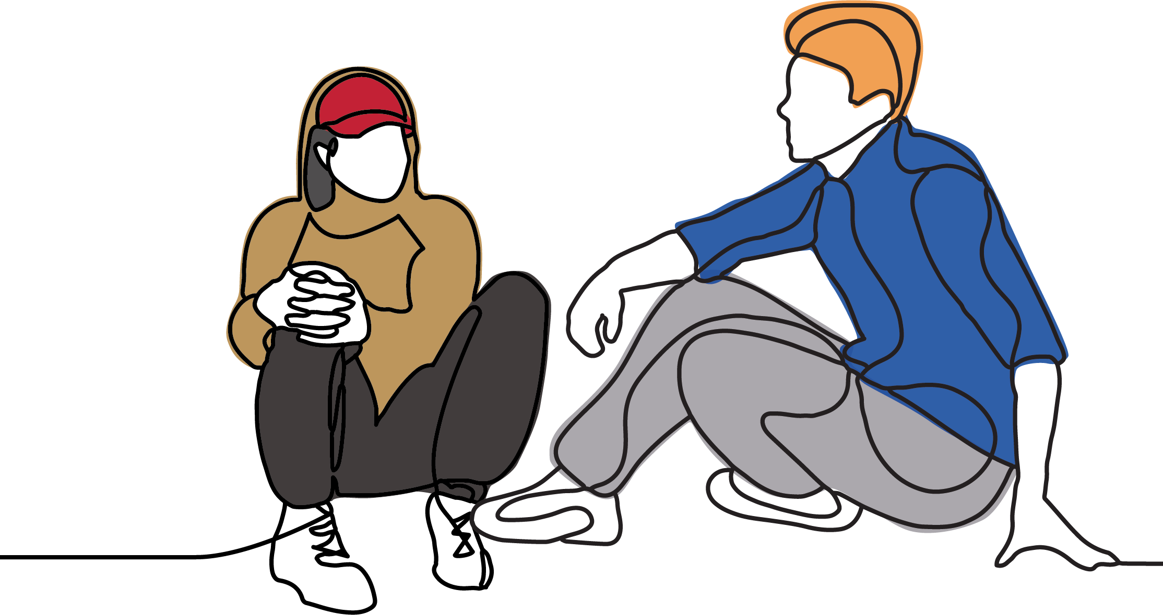
MANAGING TRAUMA-BASED BEHAVIOURS
Survival mode behaviours
Fight – Flight – Freeze - Fawn
Comfort-seeking behaviours
Self-soothing behaviours
Examples:
rocking
binge-eating
chewing on fingers
ripping out chunks of hair
chewing and eating paper
hiding food
excessive masturbation
head-banging
self-harm
Always connection before correction
Notes:
With our PACE mindset and “connection before correction” in mind, let’s think of how we might respond to a few different types of trauma-based behaviours.
First, survival mode behaviours. This is when the child “flips their lid” and responds with fight, flight, and freeze reactions. With fight, they might yell, swear, throw and break objects, hit, kick, spit, be violent, punch walls, cry, and threaten other children. With flight, they might storm out, slam the door, hide in the cupboard, climbing onto the roof, or running away. With freeze, they may go quiet, still, stare into space, or even completely dissociate. This kind of behaviour often gets a lot less negative attention from carers and teachers, because it can be easier for adults to manage – but it’s still a challenge for the child, and can mean they are missing important experiences in their day without us realising.
There’s another “F” reaction, called fawn, that’s quite new in research. This is when children instinctively react to threats with begging for forgiveness, pleases and thankyous, looking after their little siblings, perhaps even trying to make breakfast, or cleaning the bathroom. This often gets even less attention than Freeze behaviours, especially if children are successfully being helpful to adults. If the behaviour seems unusual, be mindful to consider if it’s really an intentional strategy to invest in skills or relationships, or just a desperate bid to avoid being rejected, motivated by fear and panic.
As a small aside, statistics show that freeze and fawn are more common in girls, and fight is more common in boys. For this reason, we should be careful not to underestimate the impact that trauma has on our seemingly well-adjusted girls and boys in out-of-home care, as sometimes their trauma-based survival mode behaviours can be more subtle.
Next, we have comfort-seeking behaviours, also known as “self-soothing behaviours”. This might be rocking, binge-eating, chewing on fingers, ripping out chunks of hair, chewing and eating paper, hiding food, excessive masturbation, banging their head against the wall, or self-harm. All children, regardless of trauma, engage in self-soothing behaviours, especially when stressed, to self-regulate and keep calm. However, children who have not had soothing parenting and co-regulation through their younger years may develop strange and intense behaviours because they’ve had to learn to do it for themselves.
If you see your child engaging in these comfort-seeking behaviours, should you tell them to stop? Why or why not? Guide discussion, referring back to “connection before correction”. When the child trusts the adult to soothe them when they need it, they can break the pattern of self-soothing behaviour. However, you must intervene if the child will hurt themselves or others. You can forcibly remove weapons and illicit substances from minors, though it’s preferable if you can convince them to hand it over themselves.
We always aim for connection before correction because that’s what can help the child feel safe in the moment and onwards as you build trust in your relationship. When your child’s brain feels secure that you will really never give up, it relaxes and can start to stay in control when things seem frightening or painful. This handout is a reminder for you to stick on your fridge so that you can keep this regulation in mind.
Handout – “Connection before correction”

Slide 38
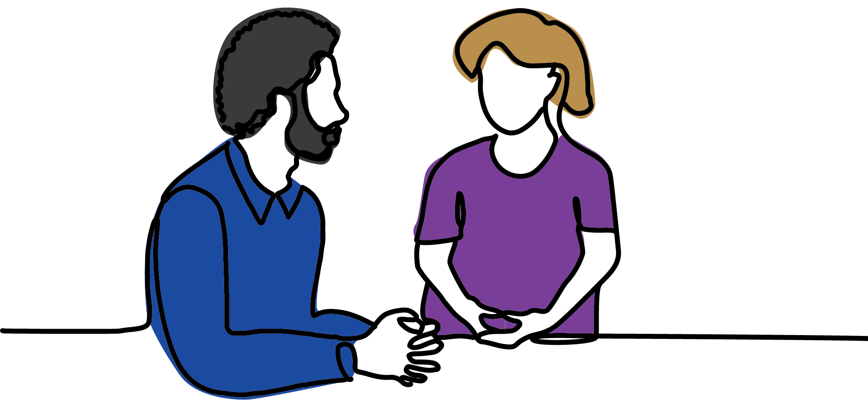
SETTING LIMITS THAT ARE EMPOWERING
Natural consequences
Embracing cause-and-effect
Limits and boundaries
Consistent routine
Incorporating play into routines
Calm brains can learn through play
Notes:
Once our children are not in crisis and their thinking brain is back online, this is the time to look at implementing natural consequences, if there are any, and adjusting the limits and boundaries if necessary.
First, natural consequences. This is about consequences that are a direct result of behaviour. The child throws their muesli bar in the bin? No muesli bar. The child punches the fan? We unplug the fan because that’s not safe. The child breaks their phone? No new phone. That said, they may actually need a phone, in which case we make a developmentally appropriate plan for them to earn enough money to contribute to a new one. Natural consequences are not punishments, they are examples of cause and effect. Children’s thinking centres need to experience cause and effect many times to develop those connections, so it’s helpful for their brain to have time to absorb the sequence: we agreed on a limit of one muesli bar per day, today’s muesli bar is in the bin, there’s no new muesli bar taking its place – perhaps they can have some fruit if they’re hungry.
Setting limits and boundaries is closely connected to maintaining consistent routines. Children may think they would prefer a life with no rules and all the muesli bars they can eat, but rules and routines that are firm and consistent provide better security and comfort for developing brains, especially for anxious brains with chaotic pasts. Children who are used to chaos may resist you introducing structure to their day, so it must be done with a playful, accepting, curious, and empathetic attitude.
When we set limits and boundaries, we are aiming for a standard that is within their reach but isn’t too easy either. A 9-year-old who has not brushed their teeth before may find toothpaste disgusting and refuse. If he can use the toothbrush with just water, then the new rule is that he brushes his teeth without toothpaste every morning. Maybe next week he can graduate to a tiny speck of non-mint toothpaste, if he feels ready. If he is not ready, that’s okay, but you’ll keep offering every so often, so he has the opportunity to try it when he does feel ready.
Our rationale for creating rules is always based in safety and comfort, and you should make an effort to explain the safety and comfort aspects of any limits you create together. Keeping consistent doesn’t mean you can never be flexible, it’s not sensible to hold children to established rules in a crisis. Parenting is always about giving children opportunities and space to try making good decisions when they can manage it, and taking over or giving extra support on days they can’t. The important part is that you’re developing what children can do, setting tiny achievable challenges in a calm atmosphere and celebrating their victories.
Transitions can be particularly challenging for children, such as moving from playtime to bedtime. It’s helpful to set expectations with a routine that plays in the same order each time. For example: pack away, brush teeth, pyjamas, book time, then bed. You can have pictures in this order on the wall, to help children visually see that the order never changes: pack away, brush teeth, pyjamas, book time, bed. As they become used to this, and start to push the boundaries of resisting routine, you can find ways to incorporate play and small challenges. Maybe there’s a bell they can ring to announce pack-away, a song for brushing teeth, and ring-ring, what’s this? Pyjama-Man just called and said they can wear their undies outside their pyjamas tonight, in case they need to fight crime in their dreams! The more fun details we can insert into these routines, the more we are bonding and building trust, and without the anxiety of being “too” affectionate.

Slide 39
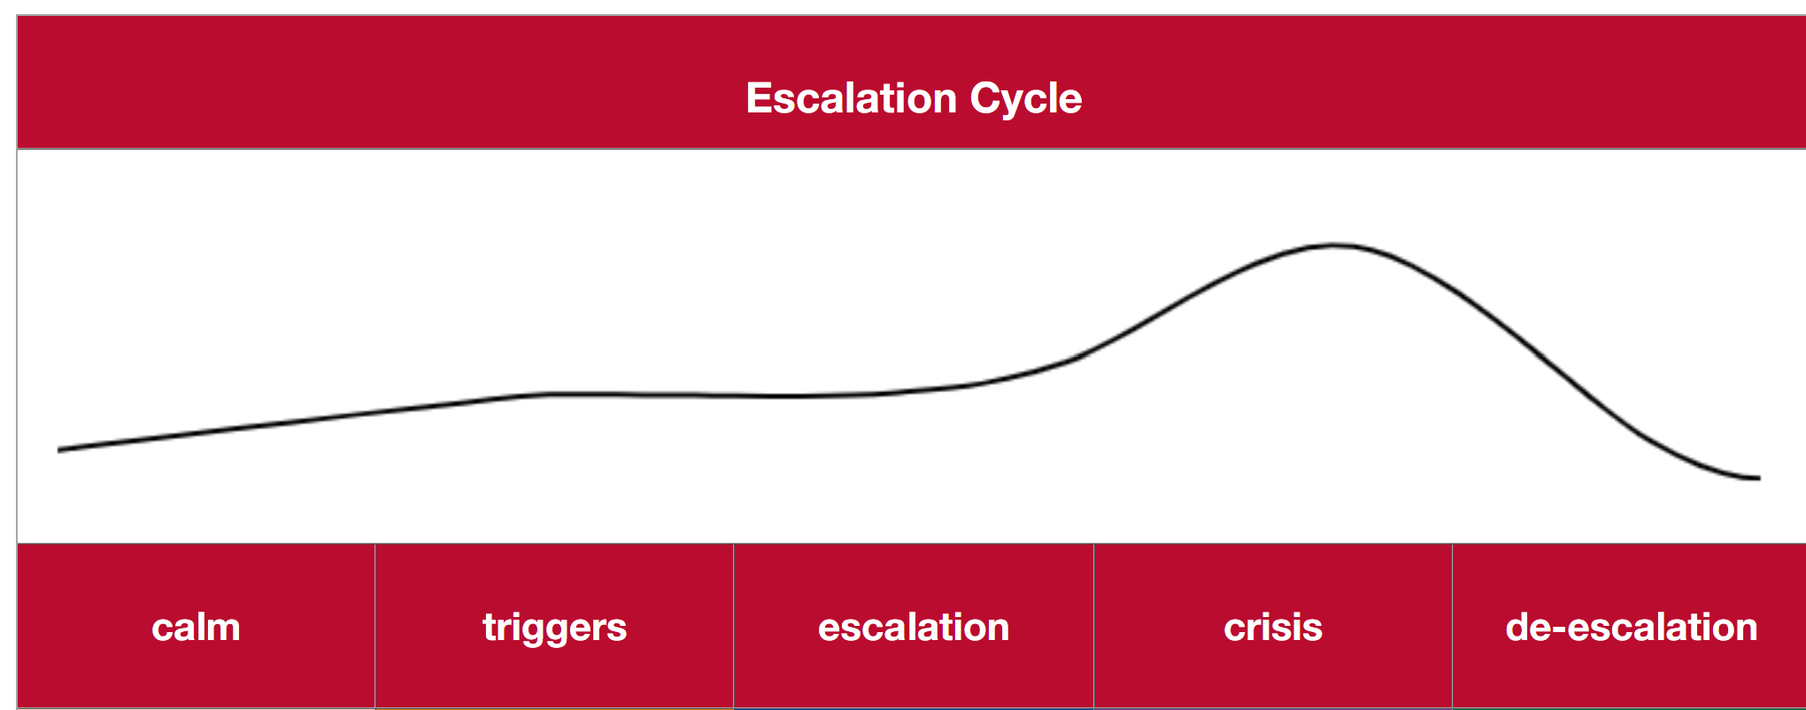
4.11 DE-ESCALATION
Additional hand-out
Notes:
Now we can start practising a PACE mindset and focus on connection before correction. But if every child is different, how do we know what to look out for? The truth is that it is very hard to see patterns in your relationship when you’re living and breathing it every day. This is why it’s helpful every few months to sit back and reflect on the progress you and your child have made, celebrate small successes, and re-evaluate your child’s changing needs as new challenges develop. Ideally, you want to do this with your case worker, because your case worker knows your situation and can see it from a distance.
Handout – “the escalation cycle”
On this handout, you can see how a 9-year-old boy called John presents at different parts of his escalation cycle, and what his foster carer can do to build safety in different stages of the cycle.
Read through the different parts of John’s escalation cycle.
On the other side, there’s a blank table for you to fill out for the child in your care. You may be starting to do this in your mind already! But when you next have a free moment, it is really helpful to take a pen and physically fill out at least one thing in each box, you’ll be surprised what new things you notice when you have to write it down. We’d also recommend doing it together with your case worker, who can help suggest things you might be too close to see.

Slide 40
Development happens through relationships Hurt brains can recover! A brain that feels safe can focus on play and learning Understanding trauma helps us respond to children by helping them feel safe Always connection before correction
Notes:
This brings us back to our key message: Always connection before correction. Applying everything we know about trauma to our care approach always boils down to building a stronger relationship with children so that they can trust us to help them when they are struggling.
Research is showing more and more that strong relationships and supports make a huge difference to our quality of life. Giving children strong relationships and supports allows them to go on to develop other strong relationships and supports that leads to calm healthy brains and better opportunities in education and work later in life.
And what about you? Who are your strong relationships and supports? This aspect of care is often overlooked, but it’s just as crucial for foster carers to have strong relationships and supports as it is for children in care. In the next module, we will look at how foster carers collaborate with the care team, intentionally use their supports to help them care, and make sure their own needs are met.

Slide 41
MODULE 5:
COLLABORATION & SELF-CARE
Notes:
This is our final module for the day, Collaboration and Self-Care. This module looks at how foster carers need to lean on the care team and look after themselves, to be able to give great care and enjoy their caring role.

Slide 42
Carers need strong relationships & supports to give children strong relationships & supports
Notes:
Our key message for this module is: Carers need strong relationships and supports to give children strong relationships and supports.
Even great carers who can stay calm, keep a playful, accepting, curious, and empathetic mindset, and focus on staying connected with their child, cannot do this without plenty of support and self-care. It takes a village to raise a child, and in out-of-home care, that village is not always easy to bring together. First, let’s have a look at the care team.

Slide 43
THE CARE TEAM
Trauma based behaviours are often also referred to as behaviours that challenge.
Who is the most important member of the care team? Why?
Notes:
What is a care team? A care team is a group of people who are important to the child or have power to approve decisions in the child’s life. You might feel that the child you care for plays nicely with your nieces and nephews, but the day care worker sees that she avoids group activities and only likes to play by herself. Perhaps your child’s case worker is suggesting reducing sibling contact, but you know that they’re better off continuing to bond with their siblings, even when visits are hard. People with different roles see a different part of your child’s story, and if your child isn’t able to articulate their needs yet, this is the team that can pool their experiences and perspectives to make all the big decisions in the best interest of the child.
In this video we’re going to hear from a few therapeutic specialists about what makes a great care team.
10 The care team approach [5mins]
Who is the most important person on the care team? Why? The video says the most important person is the carer because they have day-to-day experiences with child. Carers are in the best position to advocate for a child who cannot yet advocate for themselves. But is there anyone who knows what’s inside a child’s head better than their carer?... As children become capable of saying what they want, they begin to become the most important person on the care team, and need their foster carer to help them find the right words and encourage their questions to have agency and advocate for their own care experience.
Who do you think should be on your child’s care team? Take suggestions. This is an opportunity to reiterate that people who spend the most quality time with the child or have the strongest trusting relationship are the most valuable members of the care team. Birth family may need support to be included in the care team.
Although the most important person on the care team apart from the child is their carer, foster carers often say they don’t feel very included in the care team at all. Why do you think that is? Encourage discussion. Acknowledge that many professionals may not try very hard to include carers. Acknowledge that carers are very busy and might not realise how much support the care team is supposed to give them.

Slide 44
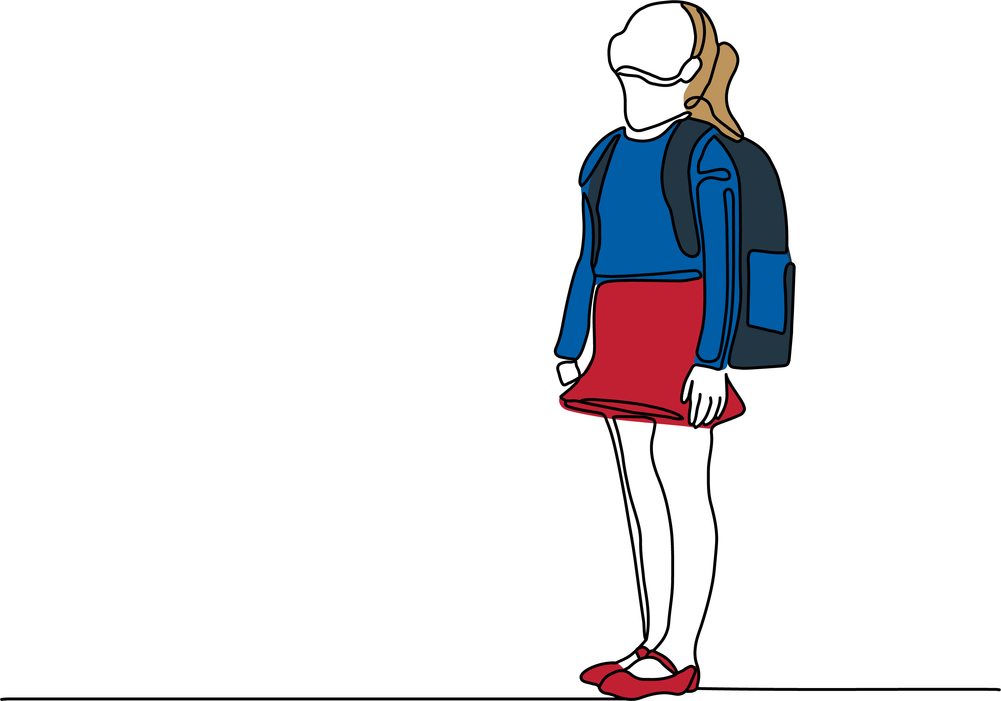
PARTICIPATION
Take charge of communication and staying in touch with the care team
Make space for children to discuss their own wants and needs
Openly ask for feedback including objecting to decisions they don’t like
Encourage attending formal and informal meetings with your support
Encourage asking for what they want
Validate their contributions as still important, no matter the outcome
How can child and carer make sure their views are considered on the care team?
Notes:
So how can the child and carer make sure their views are considered on the care team?
Firstly, the care team is not just a meeting! This is about connecting important people with what is going on at home, at school, at sport, at therapy. It is very helpful for the speech therapist to know what the occupational therapist is working on, what’s been happening at school, and how the holiday to Kangaroo Island was. When your child’s important adults are all sharing this information, they can stay on the same page and provide support consistently across different areas.
Sometimes carers feel that they don’t want to bother everybody with an email or a phone call, and can feel ambivalent about reaching out. But especially for professionals, it is their job to stay updated with children’s changing needs, and they are paid to read your emails and support you. As the child’s primary carer, your input is the most important information the care team has. Most case workers and therapists say that their favourite carers are the ones who regularly keep in touch about their child’s progress and changing needs, who can ask for help and support as soon as they begin to struggle, long before situations become critical.
OPTIONAL VIDEO: Advocating for the children in your care [8:00mins] Link: https://vimeo.com/833225597
This video is long, but uses storytelling to emphasise how important it is for carers to effortfully connect the care team. If there is at least 20 minutes left in your session, it is a wonderful video that empathises with how difficult the carer role can be.
After you play this video, give participants some extra context: As well as being kinship carers, Lynne and Noel both work as experts in out-of-home care issues. Lynne is an academic researcher in out-of-home care, and Noel is the deputy director of the CETC that provides out-of-home care training and resources to organisations and carers. If Lynne and Noel struggled to connect with their care team, it’s clearly not easy!
We hope as the out-of-home care system improves that care teams will become more and more connected. For now, if the care team is not connected, carers need to take charge of connecting their care team and ensure they are being listened to, so they can get what’s best for the child.
As children grow, carers slowly begin to make space for children to discuss their own needs and lead their own care team. We give children opportunities to say what they like and don’t like about plans, ask questions, and give them as much power as they can have over decisions that will affect them. At first, carers may just keep children in the loop on plans for things like therapy, birth family visits, case meetings, and schooling adjustments. This helps children understand that there is a care team that makes decisions together and gives them an opportunity to ask questions or give feedback on suggestions.
As the child become able to talk about what they want, carers start openly asking for feedback on plans and encouraging children to object to decisions they don’t like. Sometimes children (and their carers) don’t have the final say in decisions, especially in legal matters. But this should be expressed and recorded too. It’s important that the care team really listens to the child and tries to be flexible however they can, to try to meet the child’s needs even if they can’t have everything the way they want.
One great way to help children engage in their care plan is to encourage them to attend meetings with you, on phone, video call, or face-to-face at their preference. This is a great way to support them to engage with their care and take an active role in decisions that affect them, while they are still able to sit next to you and let you take over if they prefer to withdraw. If you know what decisions will be discussed at the meeting, you can prepare children for formal and informal processes, practise what they’re going to say, and talk about how it went afterwards.
Many children choose to actively avoid attending meetings, which in itself is a way to participate. Refusing to be present is a communication that we can accept and engage with empathetically. We can also take this opportunity to be curious about disengagement. Is there an adult who makes your child feel uncomfortable? Is there a topic they want to avoid? Is it just business settings they don’t like, could we have the meeting in a park?
Often, children disengage with opportunities to have their say because they feel their voice won’t change anything. It’s important to reassure children that even if we can’t have everything we ask for, the care team’s job is to at least try, no matter how big the request, and sometimes a care team can come up with creative solutions we would never have thought of! You can support them through this by standing with your child and prompting the care team. “Well, if we can’t fly her siblings across Australia every week as she requests, what CAN we do?”
Even if your child is not happy with the final outcome, they are still heard, validated, and responded to, which reinforces their value and builds their self-advocacy skills for future. When children keep asking for what they want regularly, that helps the adults know more about what’s important to them, which can affect how plans are made in future.

Slide 45
JUGGLING EVERYONE’S NEEDS
Child’s needs
Practical needs
Family’s needs
Your needs
Court and case worker’s needs
Notes:
Foster carers wear many hats and hold many roles in their families. You are juggling being a parent, a partner, as well as supporting other professionals and family members to interact positively in your child’s best interests, co-ordinating your care team, and going through all the extra processes that come with the care system. In your specific family, you might also be the organiser, or the decision-maker, or the peacekeeper.
If you have biological children in the house, it can be tricky to navigate issues with sharing and discipline. Sometimes you might need to adjust your discipline strategy for your biological child so that they don’t feel unfairly treated. Sometimes your family members will question how you’re responding to things. It’s not easy to juggle multiple roles across intersecting relationships, and it’s important to ensure you meet your own needs and get support if relational stress becomes an ongoing issue.

Slide 46
THE IMPACT OF TRAUMA ON CARERS
Trauma based behaviours are often also referred to as behaviours that challenge.
What does your child do that makes foster care worth all the effort?
When your child is having a rough month and is not doing those things,
how can you get those same little dopamine rewards in another way?
Notes:
We have spent a lot of this course thinking about the impact that trauma has on children who have experienced abuse and neglect, but now it is time to think about how that trauma impacts foster carers.
One of the toughest impacts of trauma for carers to deal with is that it can make children try to reject your care. Consistently trying to build a relationship with a child who is trying to avoid a relationship with you makes carers begin to feel rejected, and then defensive. Soon, carers can be moving through the motions of the day desensitised, feeling like they don’t really care so much about their child’s struggles anymore – even if they love them very much.
This is called “blocked care” and it’s a common issue that forms a cycle: children are trying to protect themselves from relationships, so carers begin to protect themselves by not letting themselves emotionally invest. We’re going to watch a short video now by a psychologist called Jon Baylin who can explain blocked care a little more.
11 Blocked Care [3mins]
What does your child do that makes foster care worth all the effort? Smiling at you, giggling, being light-hearted, showing kindness, asking politely, coming for a hug, showing you their new dance. Encourage participants to brag about how cute and great their child is.
When your child is having a rough month and is not doing those things, how can you get those same little dopamine rewards in another way? Lean on your partner, family, friends for appreciation and encouragement. Openly tell your support network they can help by telling you when you’re doing a good job. Writing down your favourite things about your child. Revisit photos and videos of times you’ve had lots of fun with your child.

Slide 47
COMPASSION FATIGUE
Compassion Fatigue
Feeling overwhelmed or fatigued for multiple weeks
Feeling defensive of your parenting, sensitive to rejection
Getting easily irritated with others, becoming socially isolated
Losing creativity and fun ideas, feeling stuck in one way to do things
Feeling cynical about foster care and the help your support network offers
Meeting the child’s practical needs but struggling to feel real pleasure in caring
Feeling caught-up with children’s behaviour rather than the meaning of behaviour
Avoiding opportunities to proactively support your child, waiting to react to mistakes
Feeling stuck on a certain outcome and finding it hard to see other types of progress
Finding yourself being snippy, sarcastic, or “zoning out” while responding to your child
Finding it hard to be “warm”, “playful”, “nurturing”, or “soothing”, and feeling guilty about this
What can carers get from family friends and professionals to help avoid or reduce compassion fatigue?
What can carers do in their own attitude and actions to help avoid or reduce compassion fatigue?
Notes:
Staying calm for every trauma-based reaction, finding fun ways to stick to structured routines, and continuously staying soothing and supporting for someone who may never thank you, who may even tell you to “eff off”, can feel exhausting and unrewarding. In several weeks or months, you start to see significant progress, and that is very rewarding. Maybe when they’re 30 they will be having lunch with you, reminiscing, retelling the funny stories, celebrating the long journey you’ve made together. But these long-term rewards of foster care are hard to imagine amidst the daily challenges that build up to desensitise carers and create compassion fatigue.
Compassion fatigue is like “carer burnout”, when the caring role is taking your energy and emotional resources faster than you can replenish it. Here are some signs of compassion fatigue.
Read through the list on the slide:
Feeling overwhelmed or fatigued for multiple weeks
Feeling defensive of your parenting, sensitive to rejection
Getting easily irritated with others, becoming socially isolated
Losing creativity and fun ideas, feeling stuck in one way to do things
Feeling cynical about foster care and the help your support network offers
Meeting the child’s practical needs but struggling to feel real pleasure in caring
Feeling caught-up with children’s behaviour rather than the meaning of behaviour
Avoiding opportunities to proactively support your child, waiting to react to mistakes
Feeling stuck on a certain outcome and finding it hard to see other types of progress
Finding yourself being snippy, sarcastic, or “zoning out” while responding to your child
Finding it hard to be “warm”, “playful”, “nurturing”, or “soothing”, and feeling guilty about this
Do some of these feel relatable? Many parents have these kinds of feelings, even when parenting biological children, but as with everything, when you add trauma to the situation it is often more intense, with more complexity.
Sometimes, carers don’t want to tell their case worker that they are struggling, because they’re worried the children might be removed. This won’t happen unless children are being abused and the carer is disengaging with supports and training. Often, the symptoms of compassion fatigue creep up on us slowly, over long months of “barely surviving” foster care before we realise that we are “flipping our lid” more easily, losing our own capacity to self-regulate, and the situation is becoming critical.
In the worst-case scenario, carers give up entirely, and cannot continue to care at all. This is called a “placement breakdown”, where the child is moved elsewhere and loses huge amounts of progress, because they’re forced to go back to the beginning again, and build a safe trusting relationship with someone new. But the child is older now, even less trusting than before, and will take even longer to start engaging with another carer. Nobody wants that. Your case worker, your care team, your agency, the DCP, everyone would rather do everything they can to give you the support you need to care, rather than see the placement break down.
What can carers get from family friends and professionals to help avoid or reduce compassion fatigue? Family and friends: babysitting, bringing a meal, phone calls, emotional support Professionals: being honest about struggling, asking for more support, even asking “what types of support can I ask for?”
What can carers do in their own attitude and actions to help avoid or reduce compassion fatigue? Support various answers. E.g. arrange breaks with partner, remind self of positives, gratitude journaling, speak positively about the child to others, write down your victories, congratulate your child on something they’ve done well, listen to good music.
Sometimes, caring for children with trauma can provoke a trauma response in foster carers and kinship carers. It’s not just the caring aspect, it’s also hard to see the impacts of horrible things that have happened to a child who you love. Over time you may come to find out more details and context of the trauma your child has faced, which can sometimes bring relief to understand your child better and can sometimes be seriously distressing or disturbing. This can be even more complicated when the traumas that your child survived may remind you of traumas that you yourself survived.
The vicarious trauma of ongoing exposure to your child’s trauma can become severe enough that carers may even develop Secondary Traumatic Stress, where they may experience symptoms similar to Post-Traumatic Stress Disorder even though they did not directly experience these traumatic events. If you think this might be happening to you, it’s important to talk to your case worker about it and follow up with a mental health professional.

Slide 48
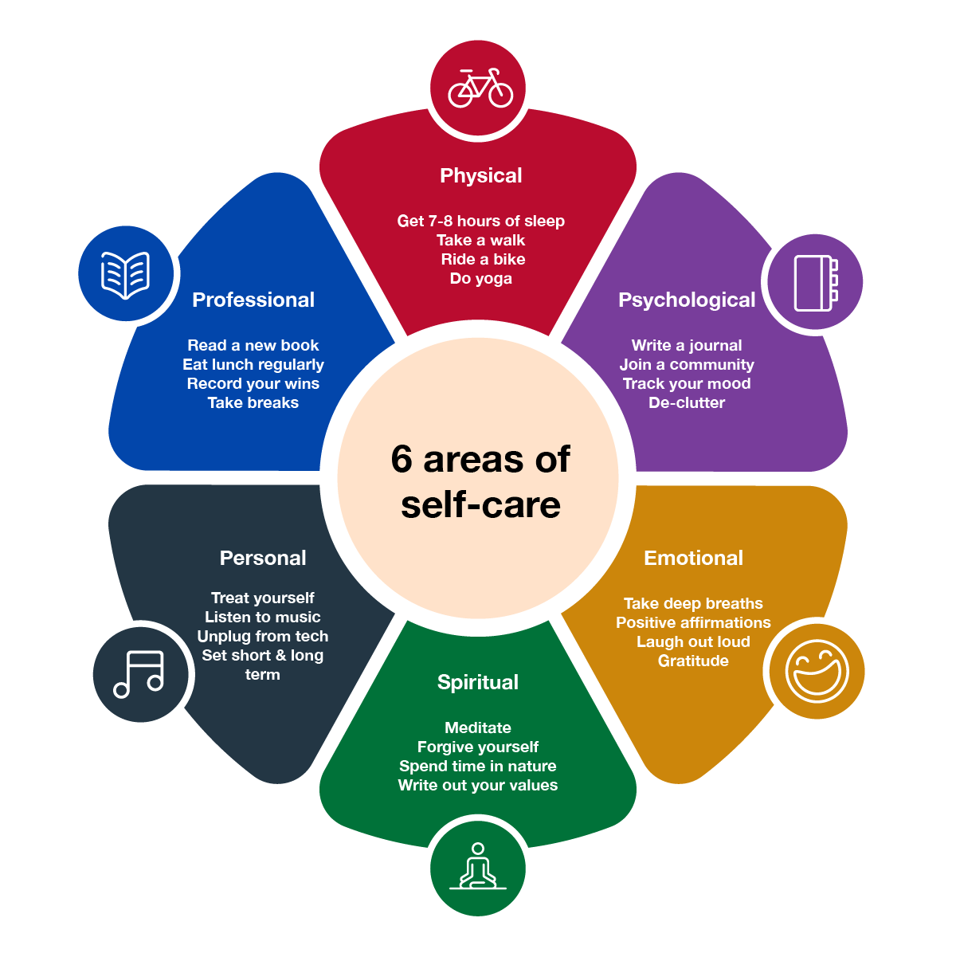
SUPPORTING SELF-CARE
Trauma based behaviours are often al
How can you resource yourself to look after your own needs
when you are caring for a child with trauma?
Notes:
In this video we’re going to hear about the importance of looking after yourself when you’re looking after a child who has experienced trauma.
12 Self Care [1:30mins]
How can you resource yourself to look after your own needs, when you are caring for a child with trauma? Open discussion. Support participants’ different ideas.

Slide 49
Development happens through relationships Hurt brains can recover! A brain that feels safe can focus on play and learning Understanding trauma helps us respond to children by helping them feel safe Always connection before correction Carers need strong relationships & supports to give children strong relationships & supports
Notes:
This brings us back to our final key message: Carers need strong relationships and supports to give children strong relationships and supports.

Slide 50
SUMMARY & REFLECTION
Relationships
to feel safe
Safety
to be safe
Playing & Learning
to develop in safety
What part of practising trauma-informed care comes least naturally to you?
What’s something you learnt today that you think you can start using immediately?
What’s something you learnt today that you’d like to work on over the coming weeks?
What is your greatest strength as a foster carer practising trauma-informed care?
Notes:
Now that we are coming to the end of our training, let’s take a moment to reflect on what we’ve learnt. A lot of what we’ve learnt today is easy to talk about conceptually, but is not so easy to put into practice in the trickier moments of looking after the child in your care.
It takes understanding what you’ve learnt, staying calm, staying connected, as well as getting enough support to be able to meet your needs, so that you can keep up your efforts to provide trauma-informed care with a playful, accepting, curious, and empathetic mindset. It also takes a calm and reflective attitude to highlight children’s progress and changing needs, as well as your own progress and changing needs.
Let’s now take turns to briefly answer these four questions and reflect on what you’ve learnt today.
What part of practising trauma-informed care comes least naturally to you?
What’s something you learnt today that you think you can start using immediately?
What’s something you learnt today that you’d like to work on over the coming weeks?
What is your greatest strength as a foster carer practising trauma-informed care?

Slide 51
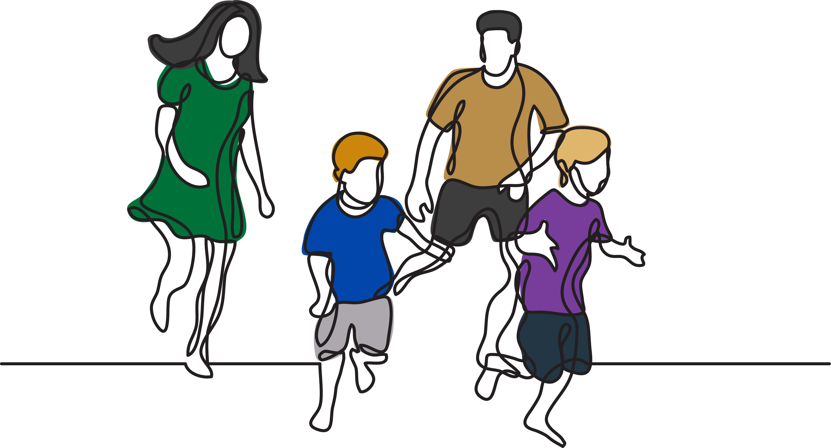
Congratulations! https://www.surveymonkey.com/r/SAFtoFcarertraining
Notes:
Congratulations on completing Caring for children and young people with trauma!
Distribute prepared certificates of completion and encourage participants to fill out the evaluation form. Use this time to field final questions participants may have, and farewell participants as they leave.

